Slide 1
Global Strategy for the Diagnosis, Management, and Prevention of Chronic Obstructive Pulmonary Disease (GOLD) teaching slide set 2025 Title slide
Teaching
Slide Set
Global Strategy for the Diagnosis, Management, and Prevention of
Chronic Obstructive Pulmonary Disease
This slide set is restricted for academic and educational purposes only. Use of the slide set, or of individual slides, for commercial or promotional purposes requires approval from GOLD.

Slide 2
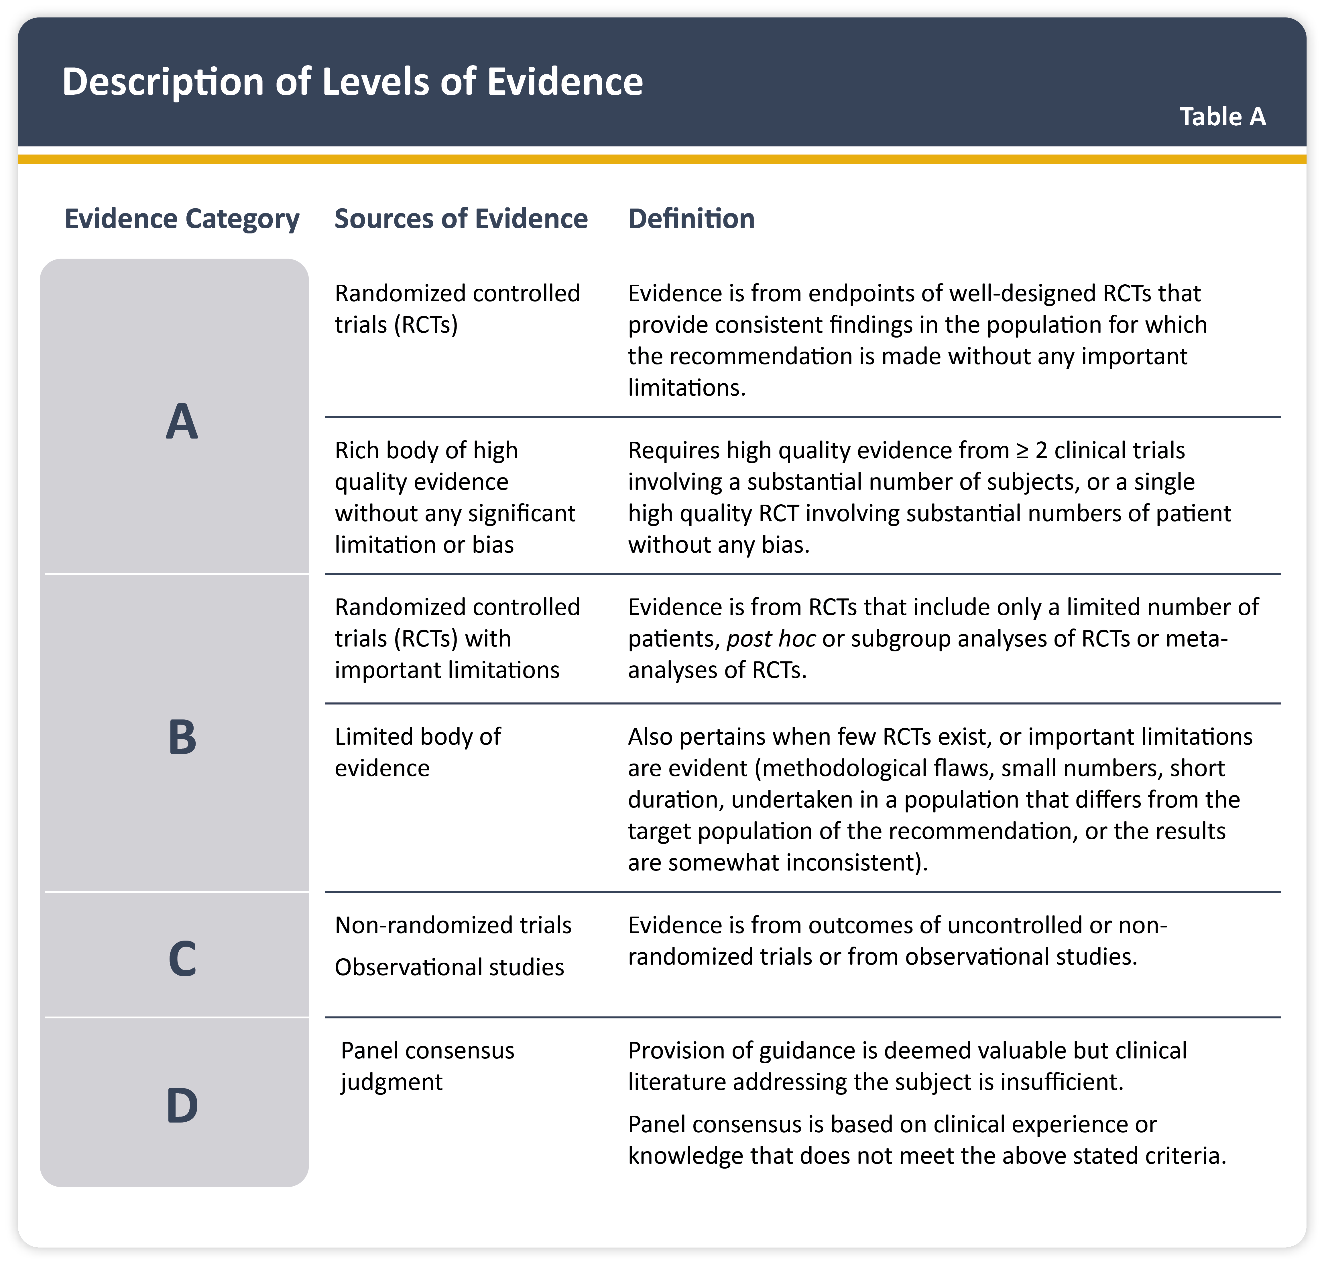
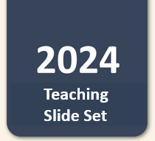
Description of levels of evidence
Teaching
Slide Set

Slide 3
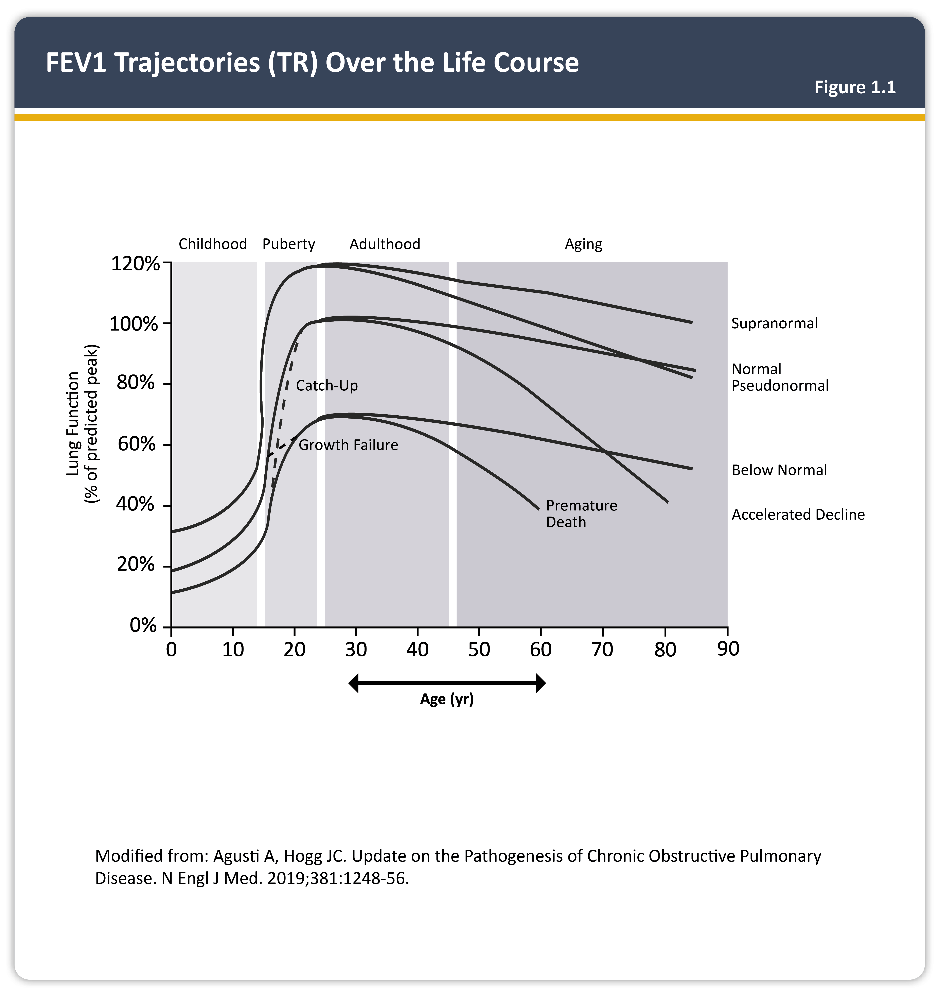
FEV1 trajectories over the life course

Slide 4
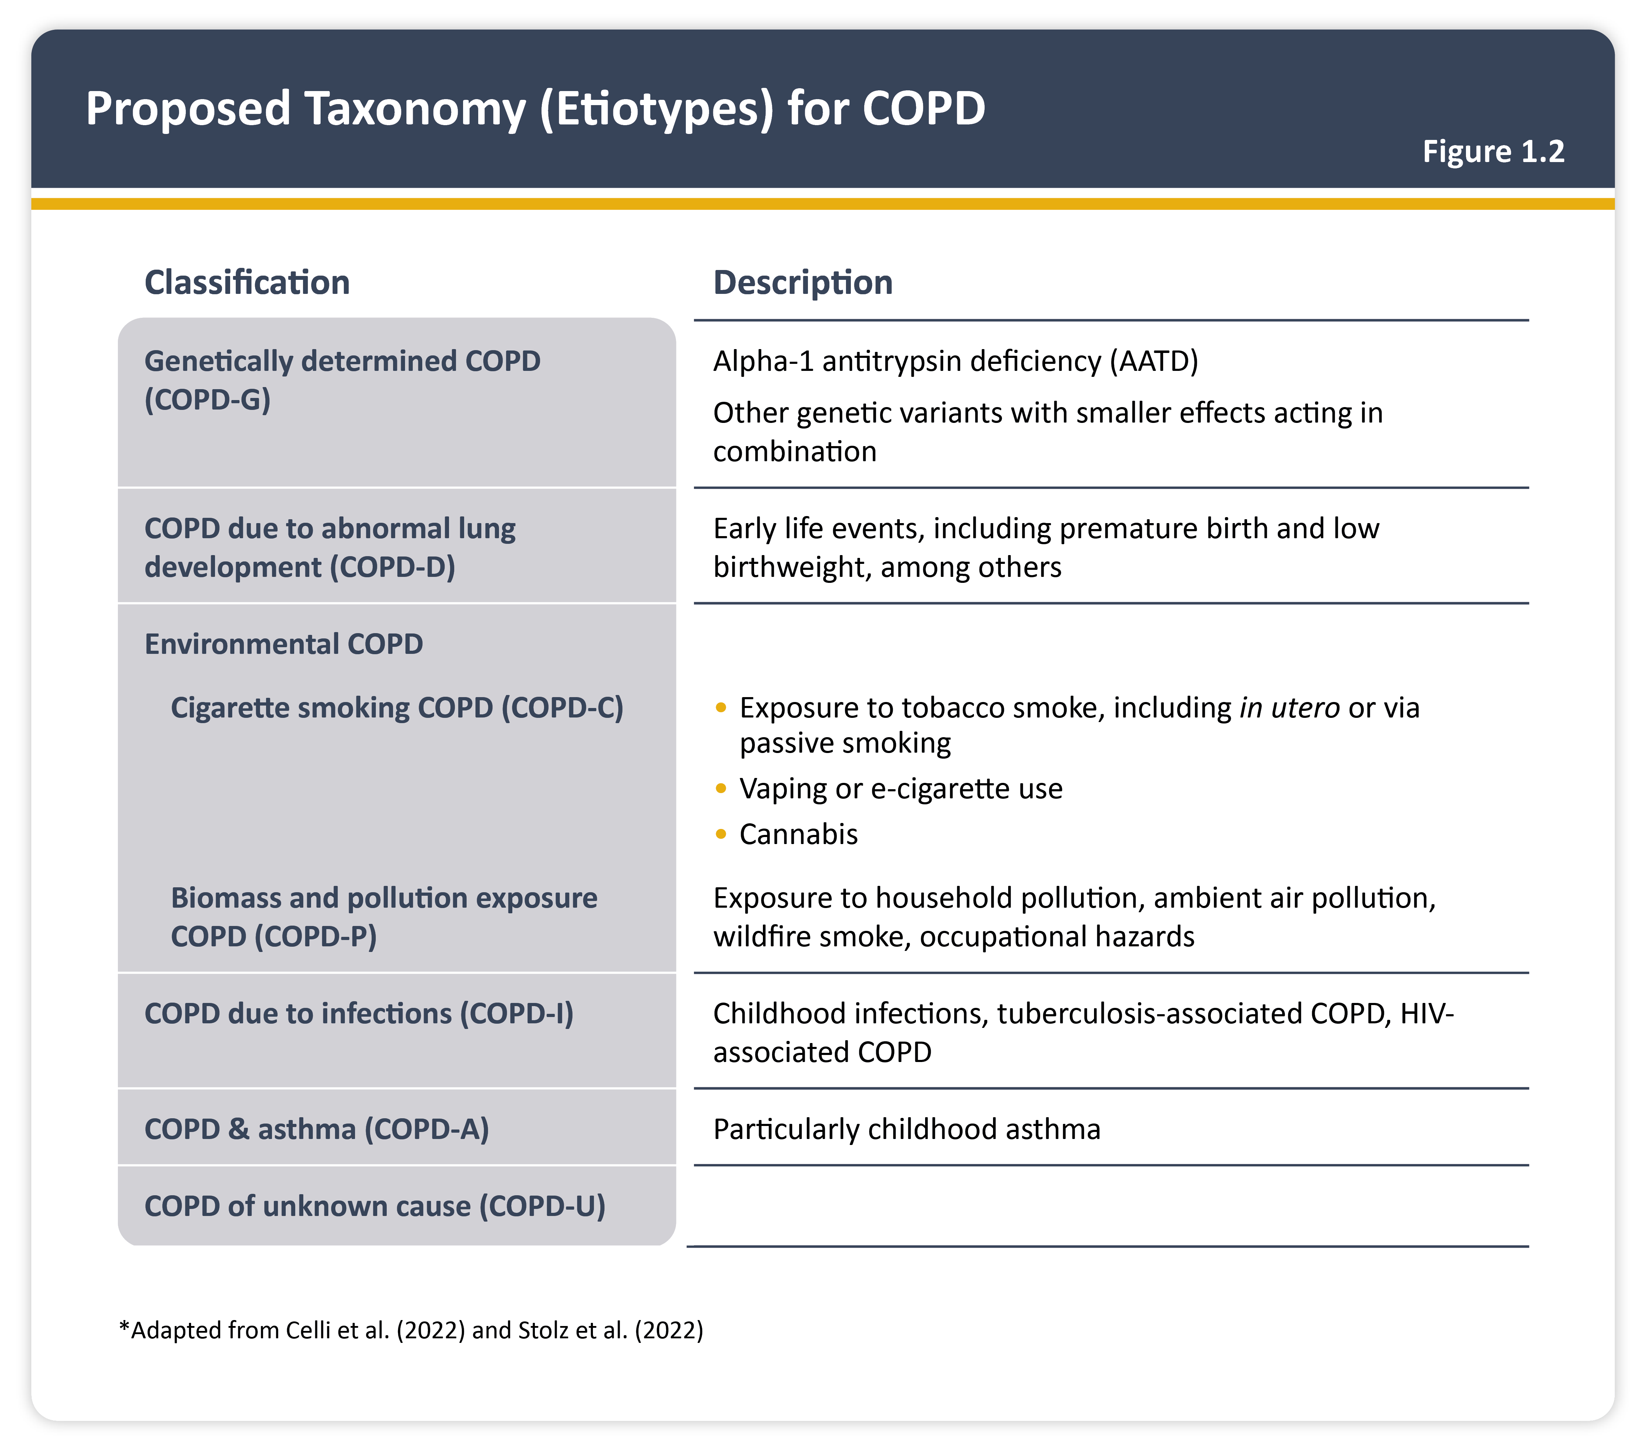
Proposed taxonomy (etiotypes) for COPD
Teaching
Slide Set

Slide 5
Clinical indicators for considering a diagnosis of COPD
Teaching
Slide Set

Slide 6
Other causes of chronic cough
Teaching
Slide Set

Slide 7
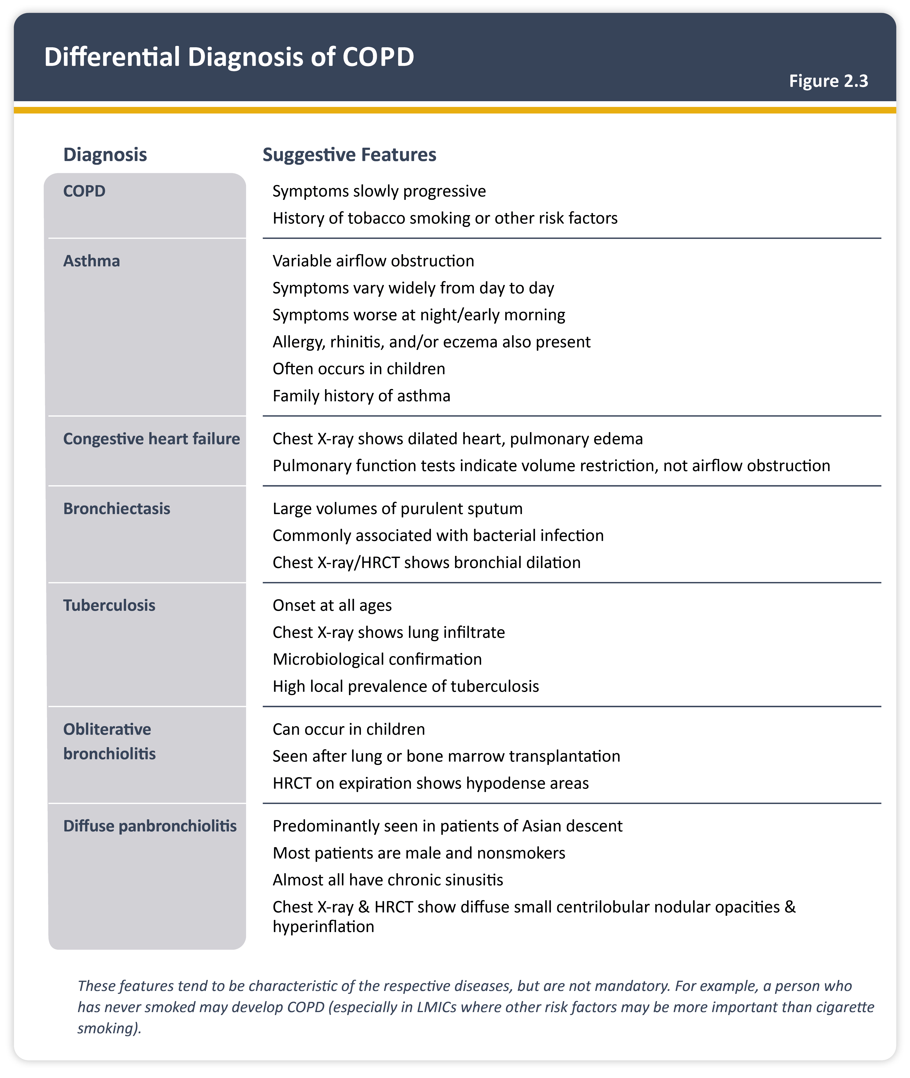
Differential diagnosis of COPD
Teaching
Slide Set

Slide 8
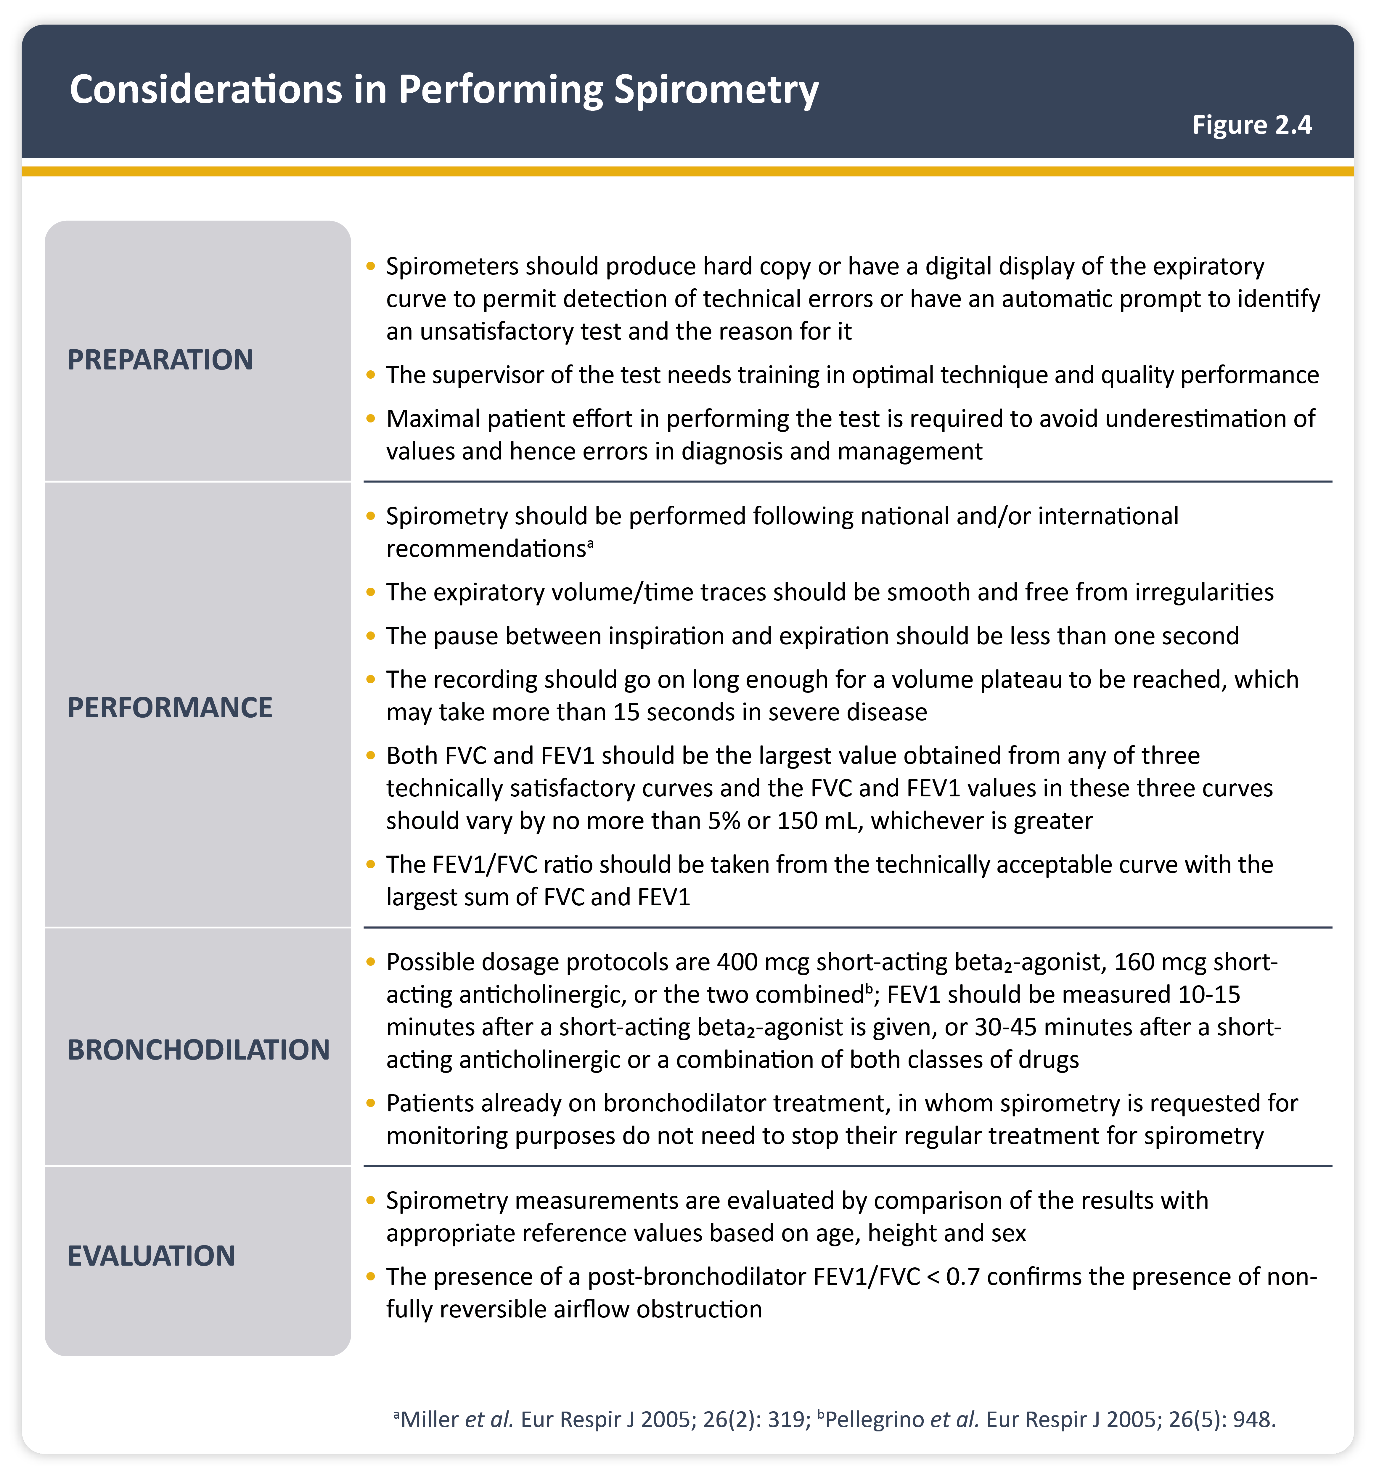
Considerations in performing spirometry
Teaching
Slide Set

Slide 9
Spirometry normal trace and airflow obstruction
Teaching
Slide Set

Slide 10
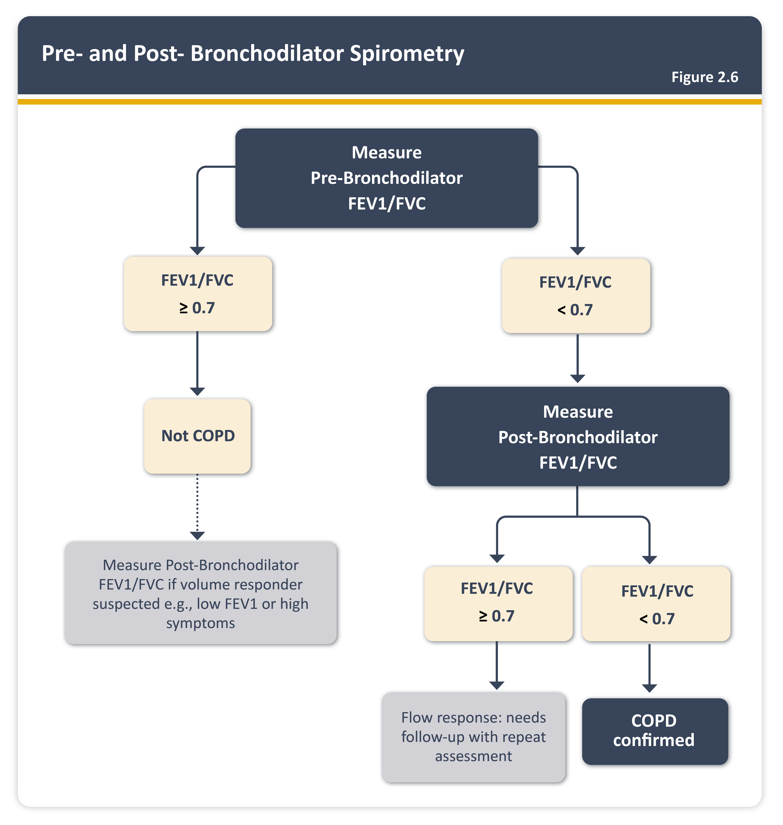
Pre- and Post- Bronchodilator Spirometry
Teaching
Slide Set

Slide 11
Role of spirometry in COPD
Teaching
Slide Set

Slide 12
GOLD grades and severity of airflow obstruction
Teaching
Slide Set

Slide 13
Modified MRC dyspnea scale
Teaching
Slide Set

Slide 14
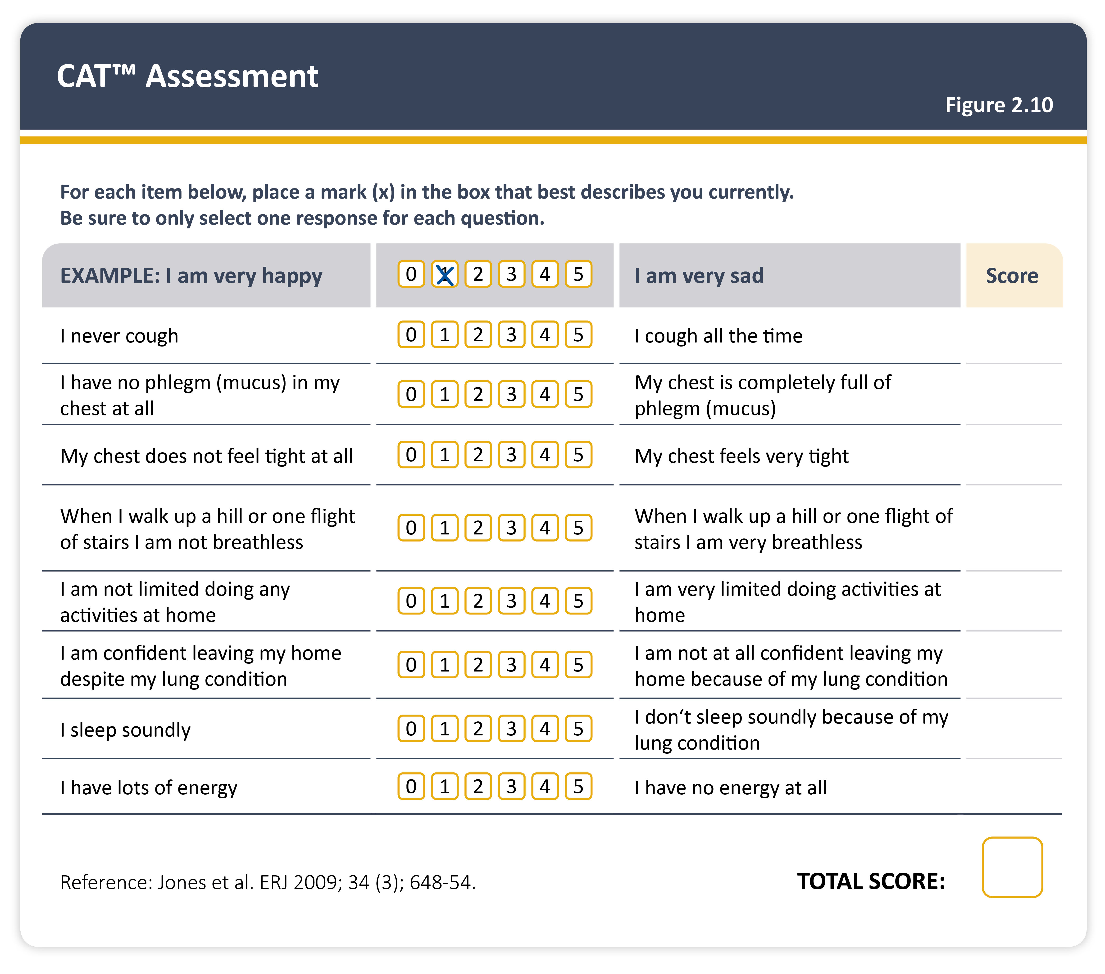
CAT assessment
Teaching
Slide Set

Slide 15
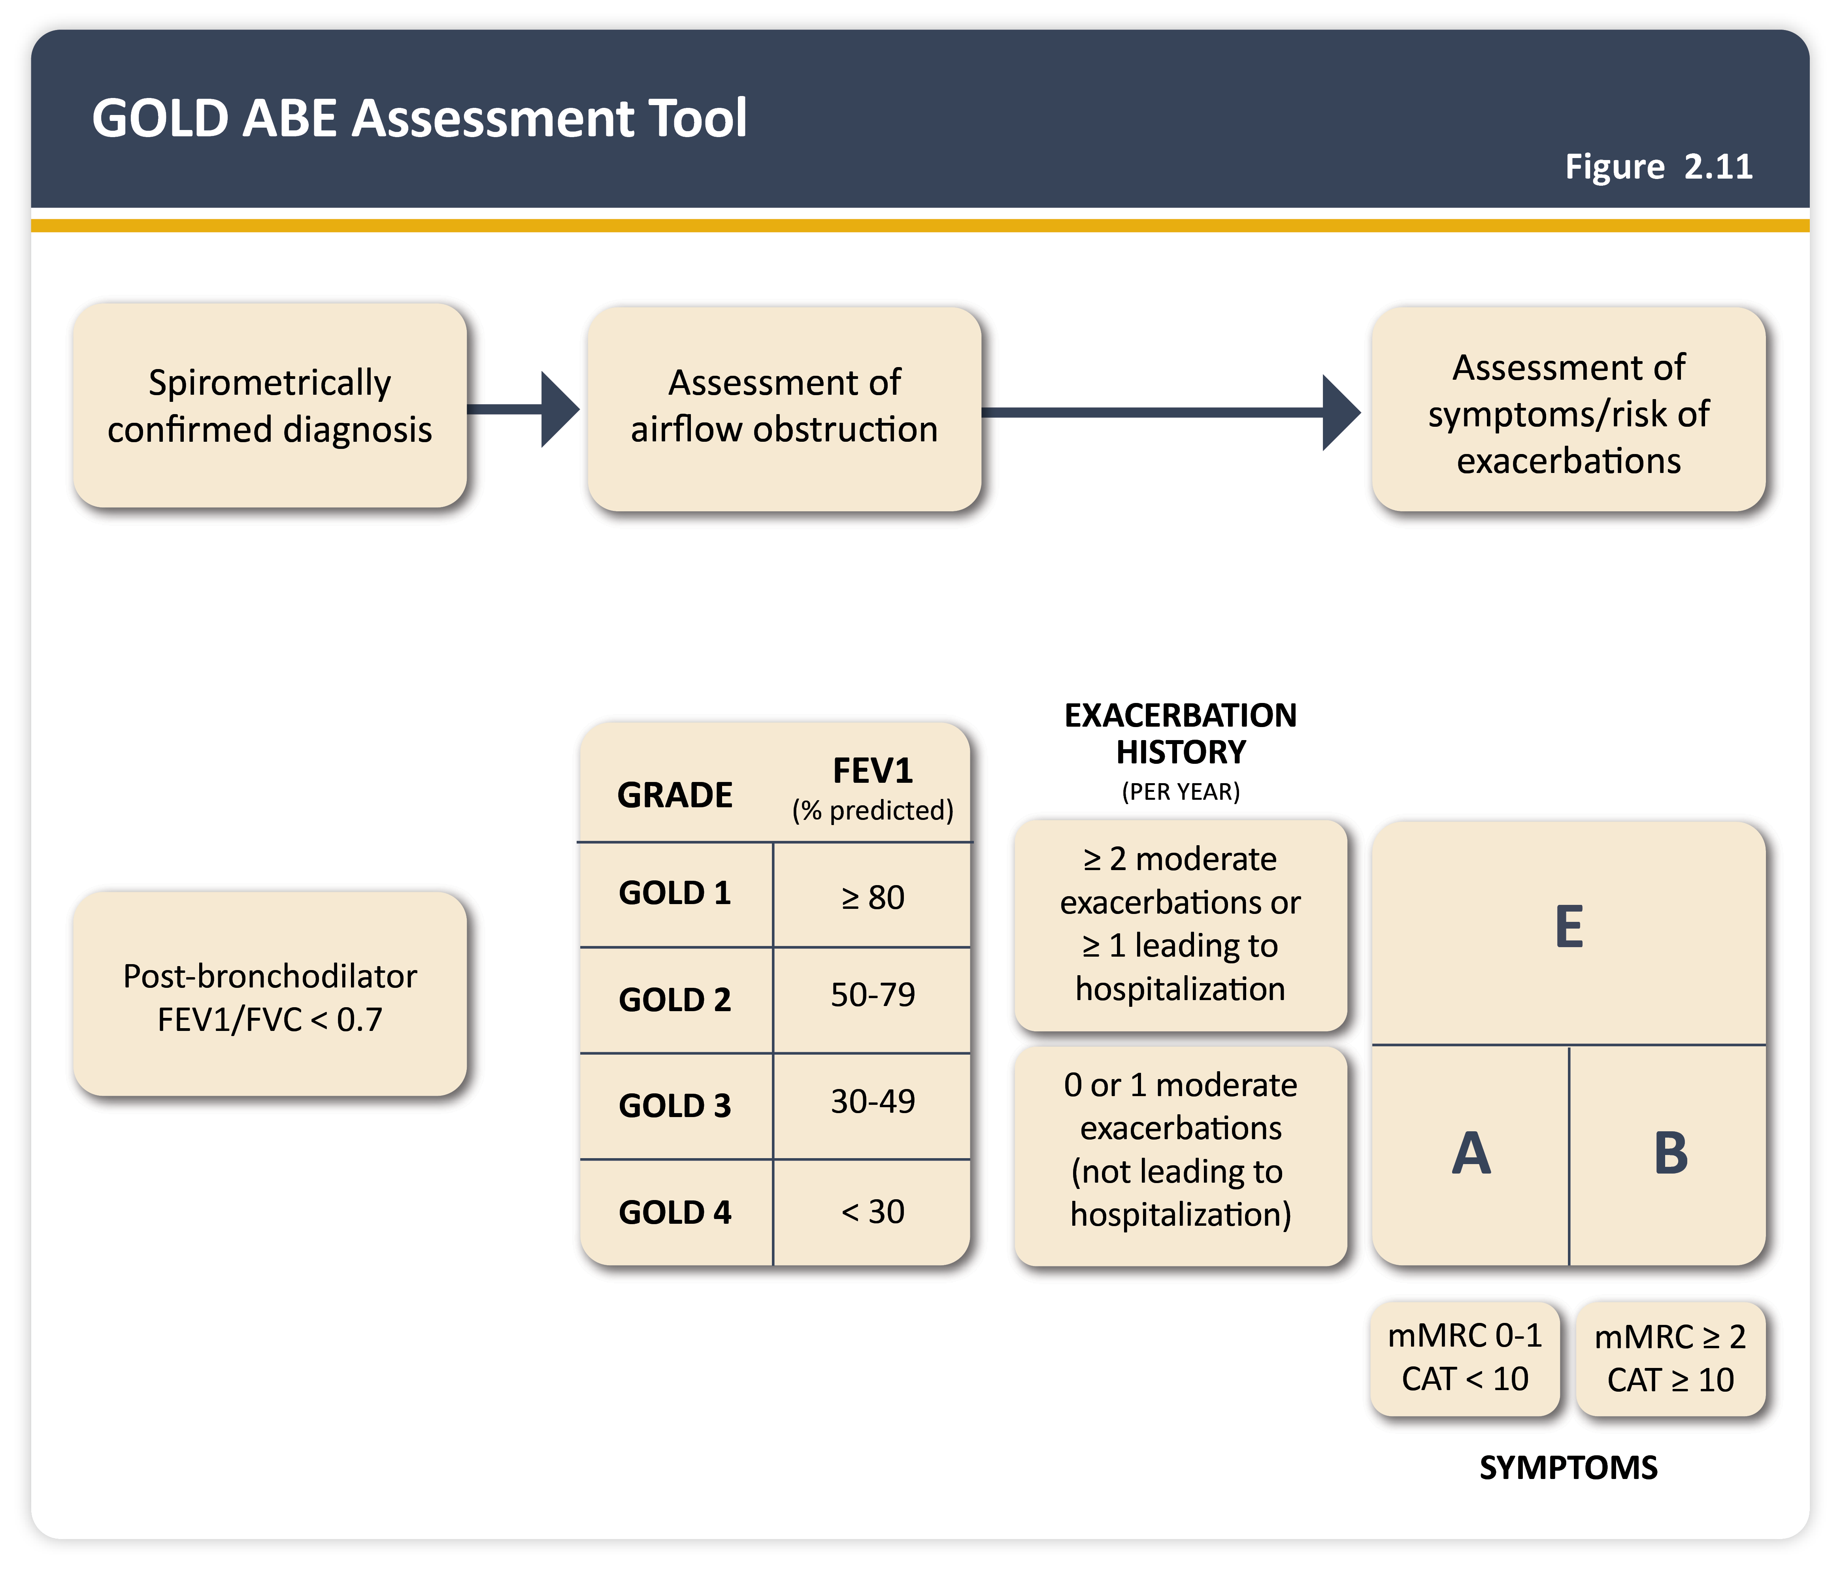
GOLD ABE assessment tool
Teaching
Slide Set

Slide 16
Use of CT in stable COPD
Teaching
Slide Set

Slide 17
Goals for treatment of stable COPD
Teaching
Slide Set

Slide 18
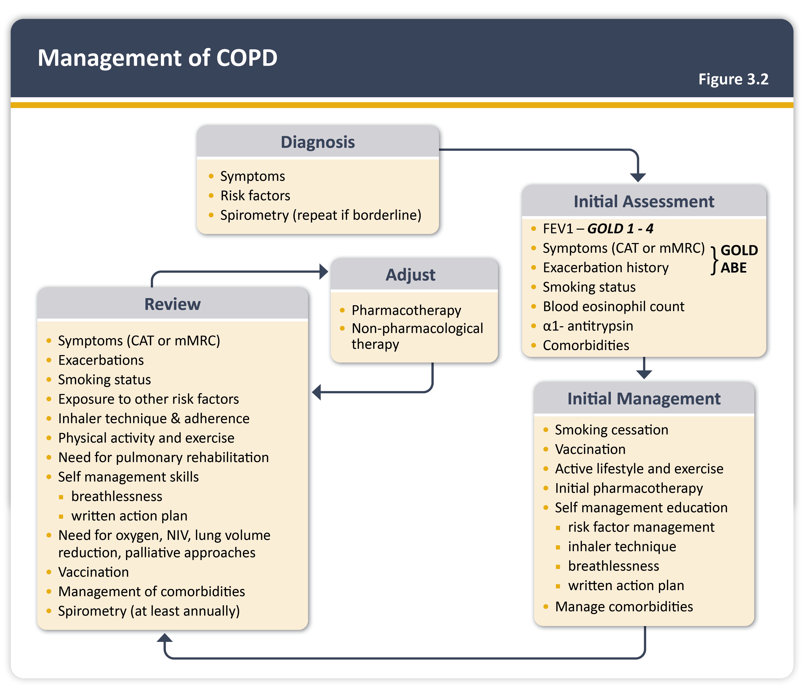
Management of COPD
Teaching
Slide Set

Slide 19
Identify and reduce risk factor exposure
Teaching
Slide Set

Slide 20
Brief strategies to help the patient willing to quit
Teaching
Slide Set

Slide 21
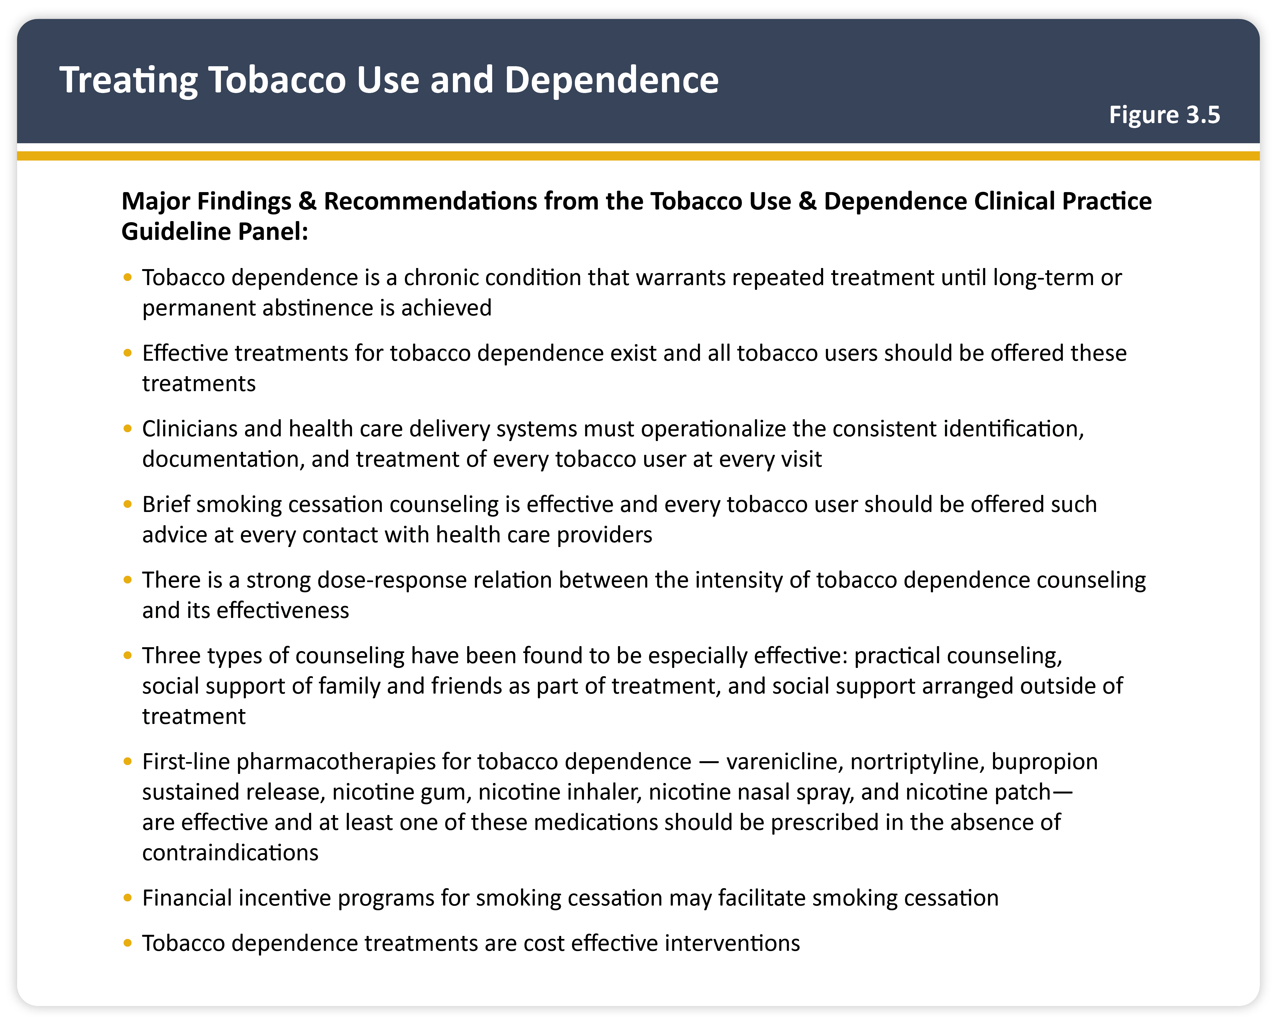
Treating tobacco use and dependence
Teaching
Slide Set

Slide 22
Vaccination for stable COPD
Teaching
Slide Set

Slide 23
Initial pharmacological treatment
Teaching
Slide Set

Slide 24
Management cycle
Teaching
Slide Set

Slide 25
Follow-up pharmacological treatment
Teaching
Slide Set

Slide 26
Key points for inhalation of drugs
Teaching
Slide Set

Slide 27
Basic principles for appropriate inhalation device choice
Teaching
Slide Set

Slide 28
Non-pharmacological management of COPD
Teaching
Slide Set

Slide 29
Follow-up of non-pharmacological treatment
Teaching
Slide Set

Slide 30
Oxygen therapy and ventilatory support in stable COPD
Teaching
Slide Set

Slide 31
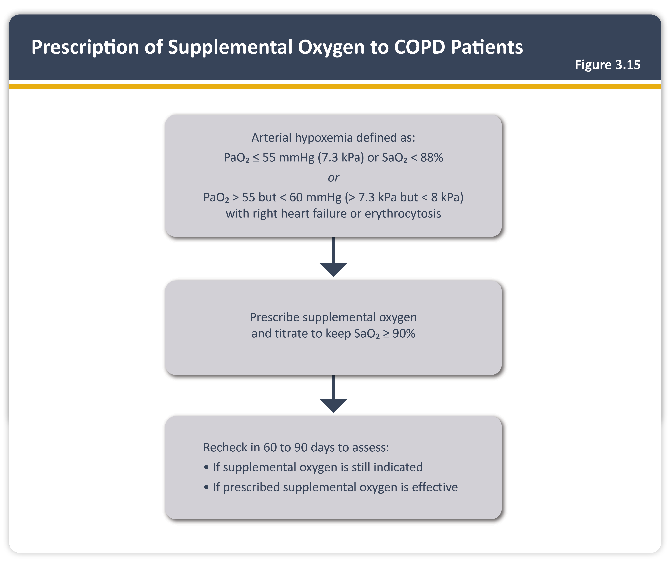
Prescription of supplemental oxygen to COPD patients
Teaching
Slide Set

Slide 32
Palliative care, end of life, and hospice care in COPD
Teaching
Slide Set

Slide 33
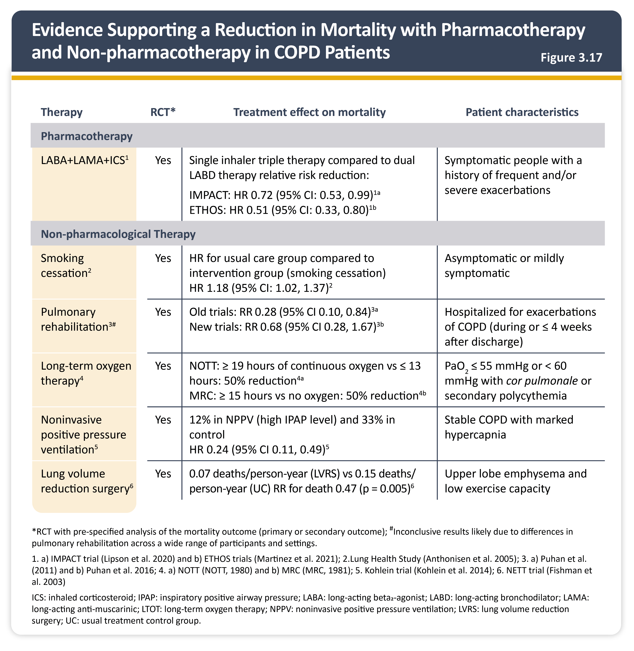
Evidence supporting a reduction in mortality with pharmacotherapy and non-pharmacotherapy in COPD patients
Teaching
Slide Set

Slide 34
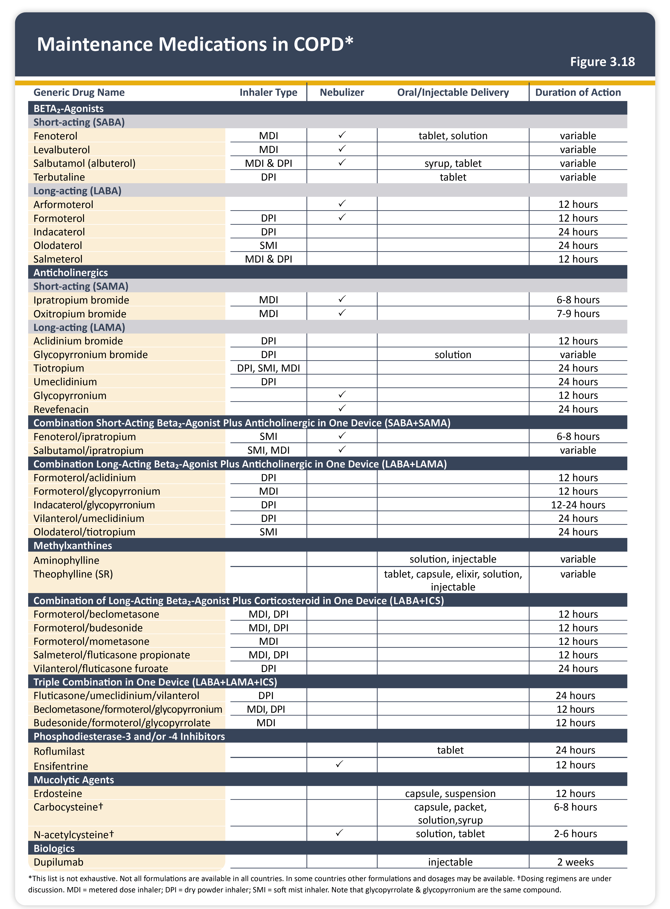
Maintenance medications in COPD
Teaching
Slide Set

Slide 35
Bronchodilators in stable COPD
Teaching
Slide Set

Slide 36
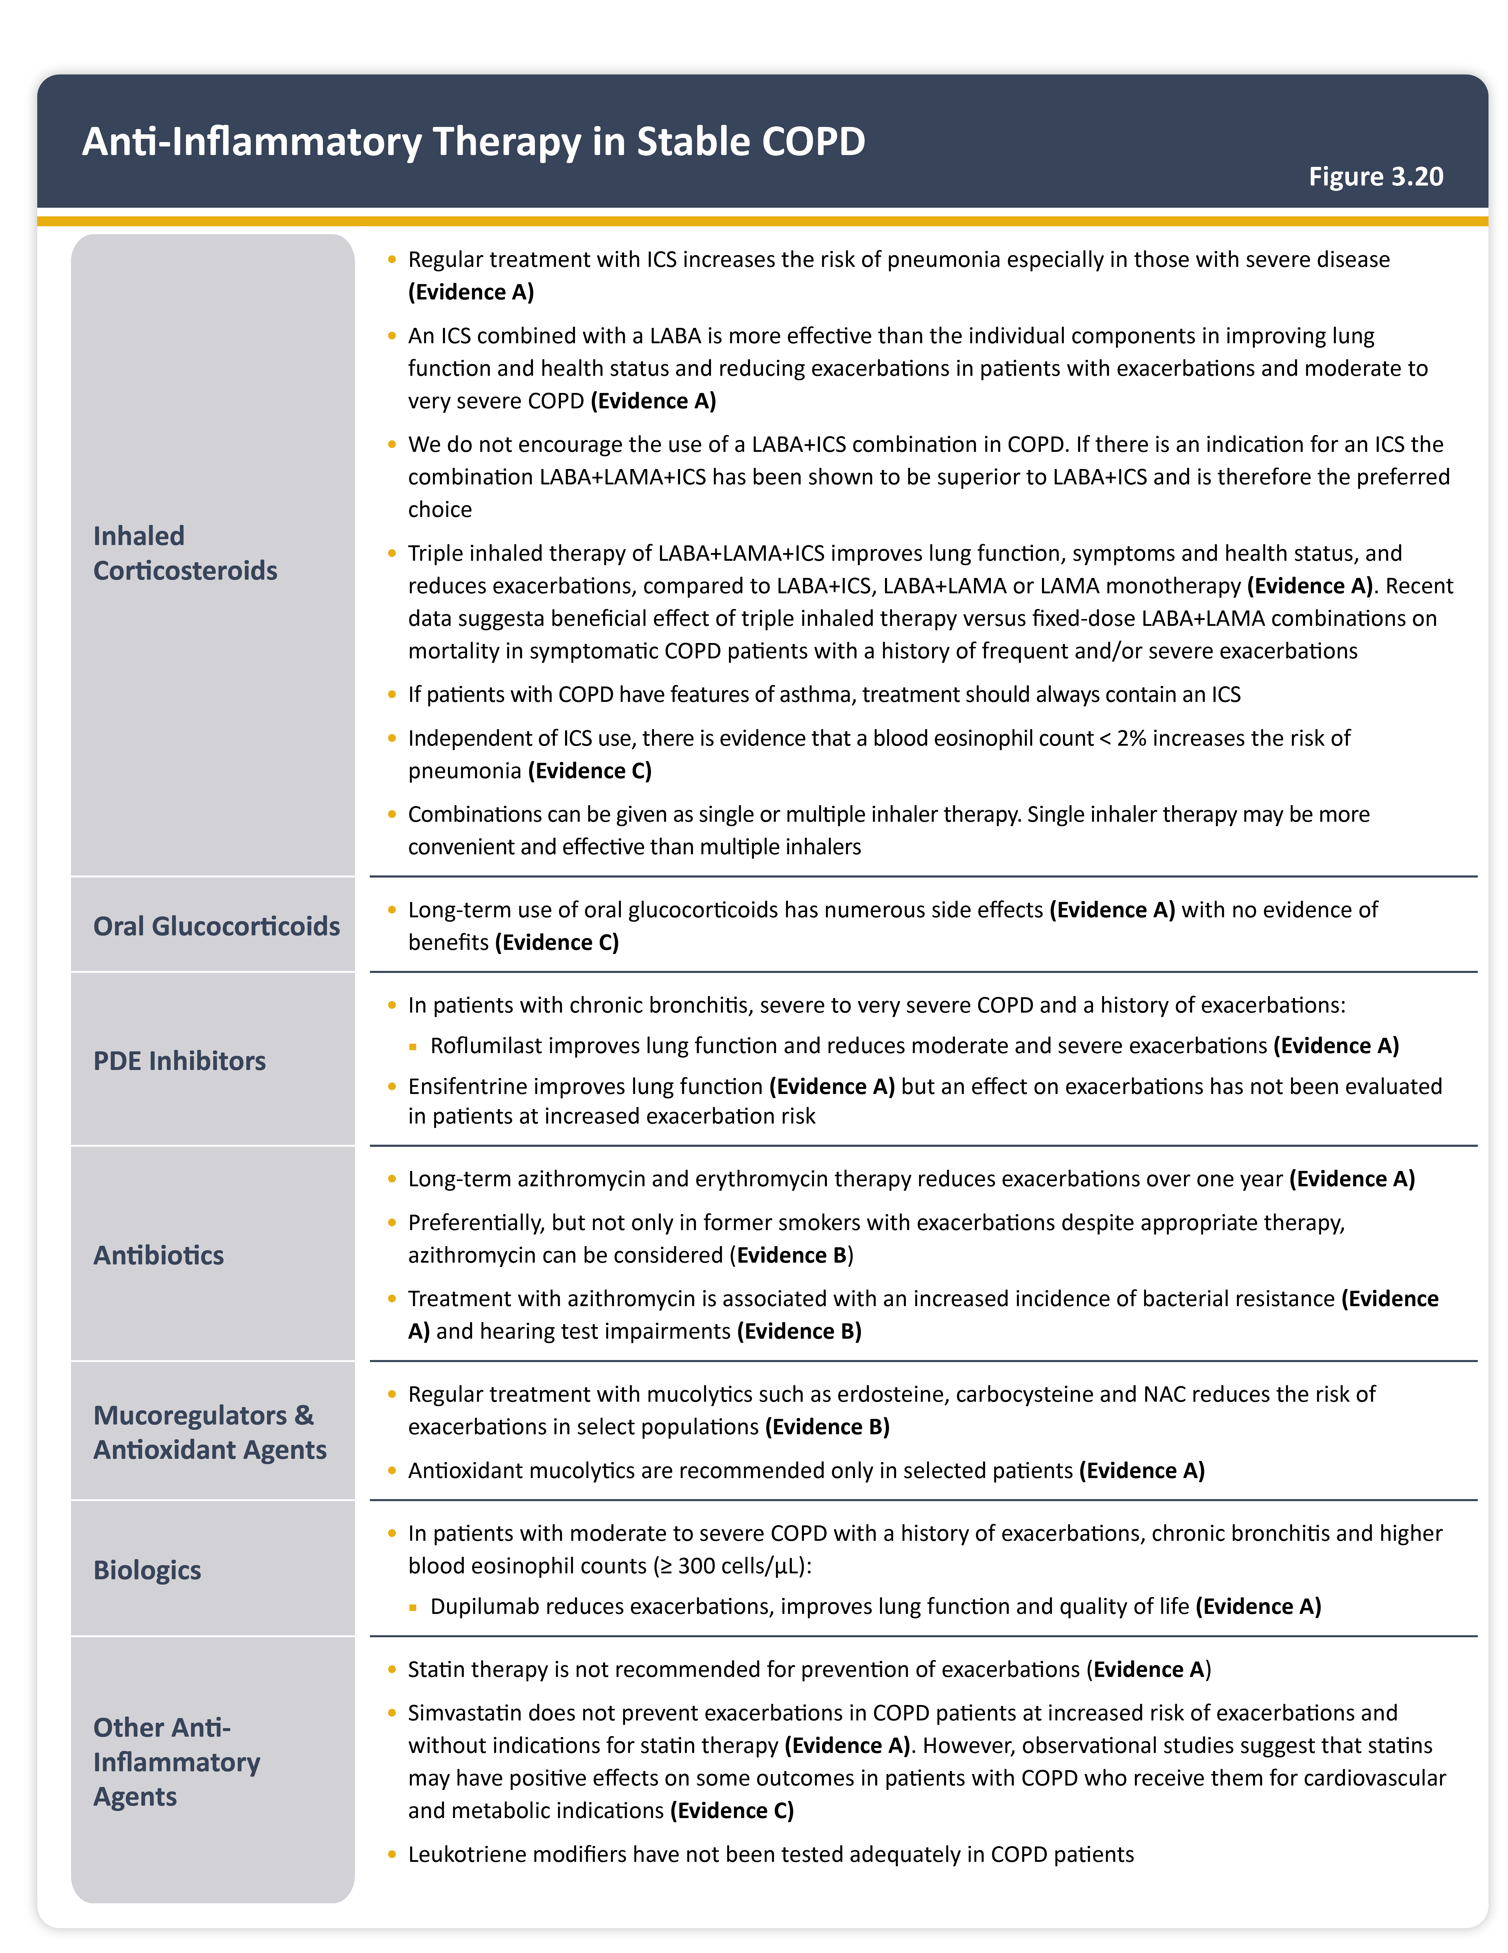
Anti-inflammatory therapy in stable COPD
Teaching
Slide Set

Slide 37
Factors to consider when initiating ICS treatment
Teaching
Slide Set

Slide 38
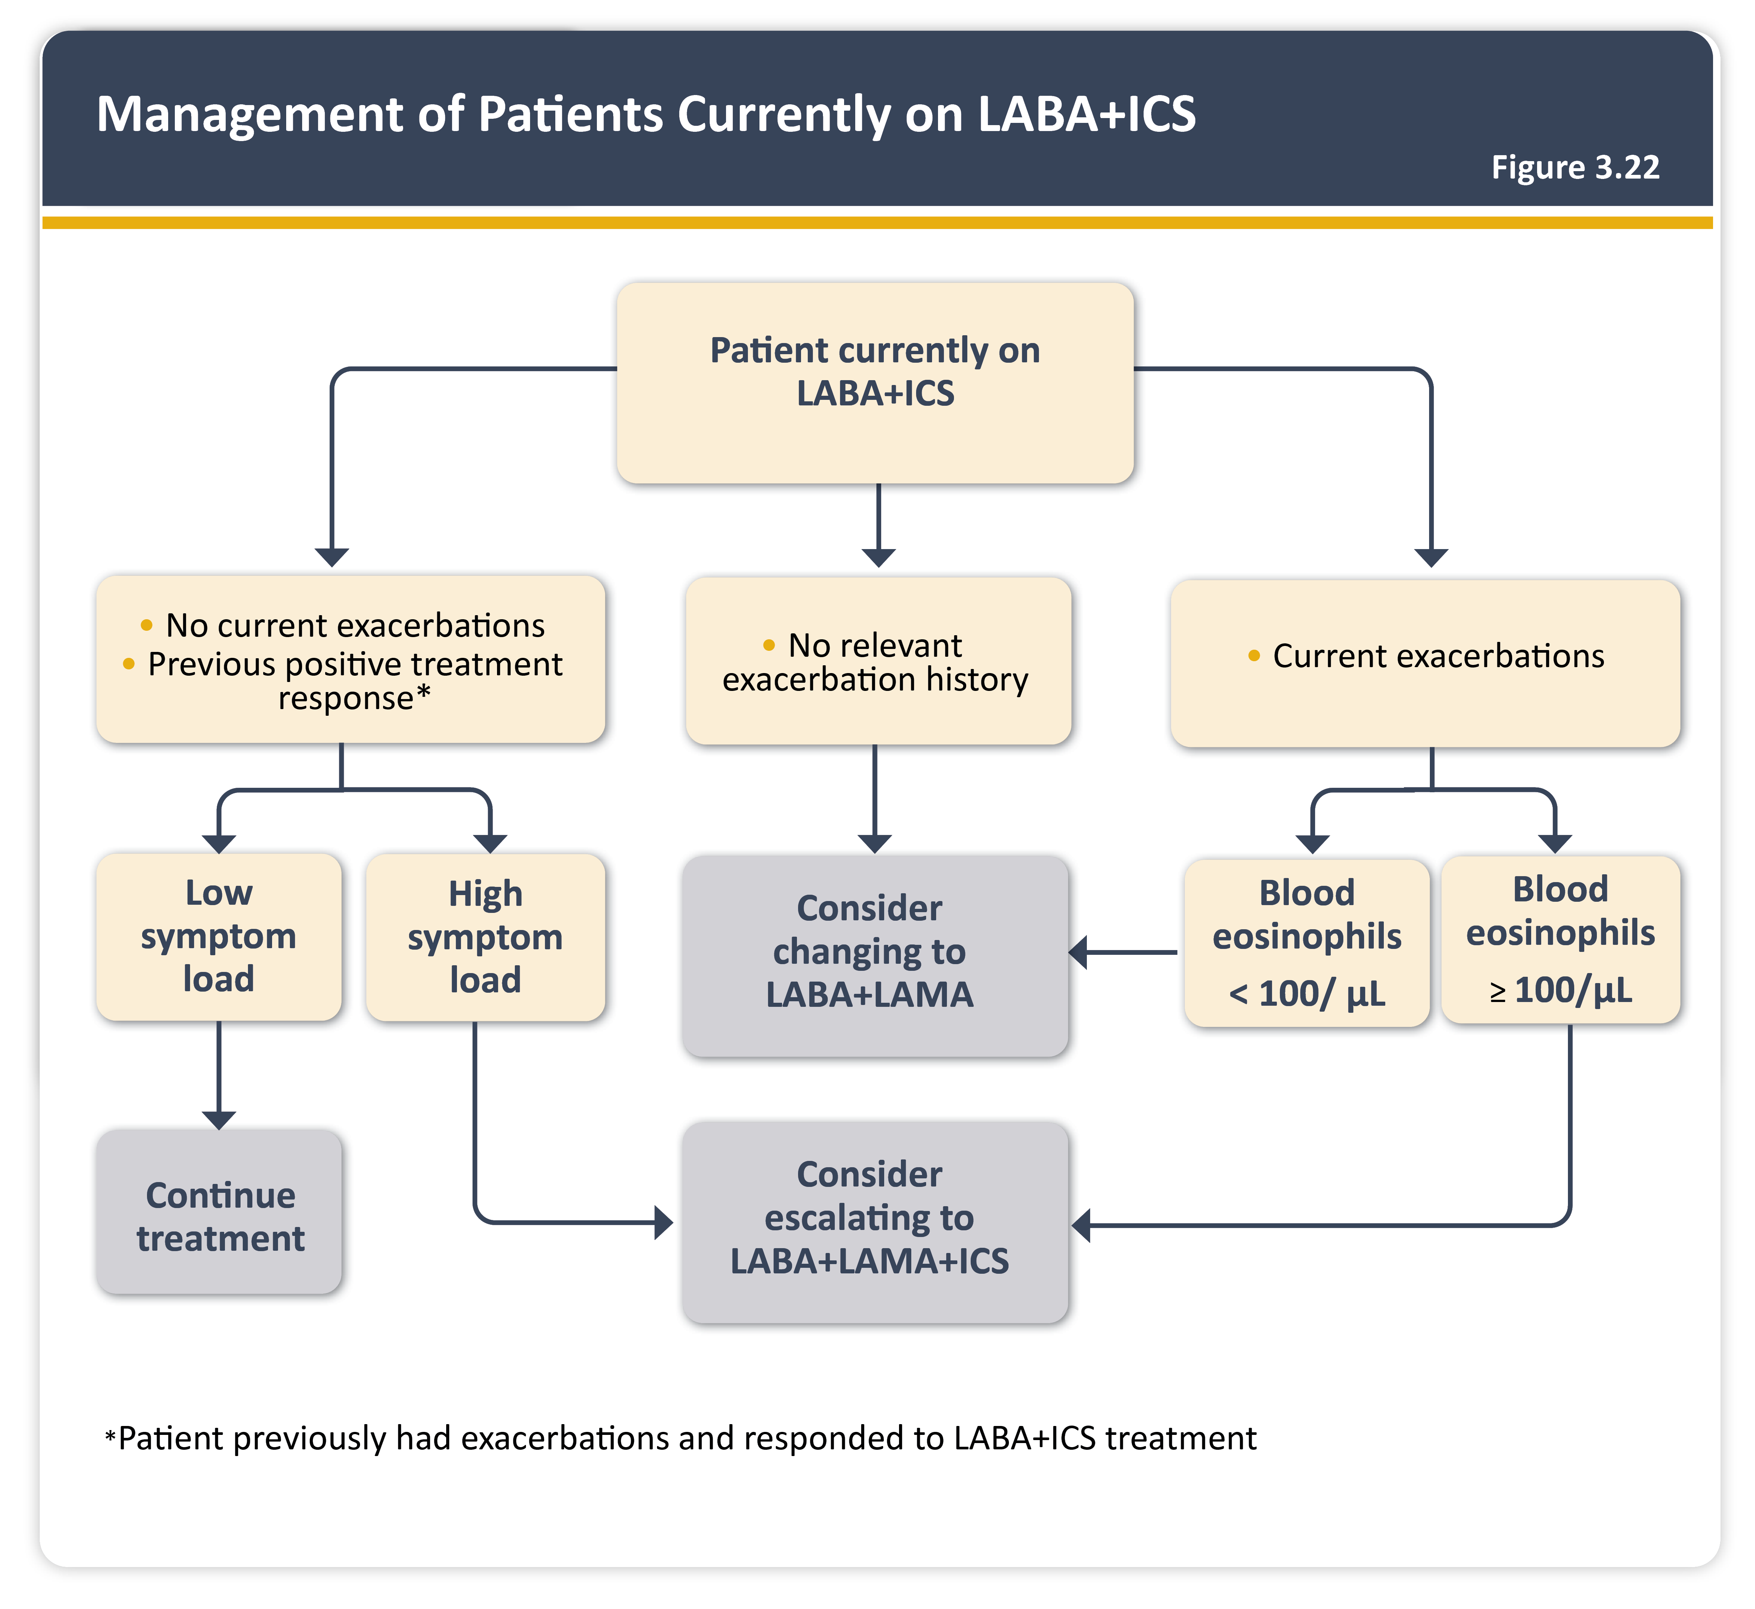
Management of patients currently on LABA plus ICS
Teaching
Slide Set

Slide 39
Other pharmacological treatments
Teaching
Slide Set

Slide 40
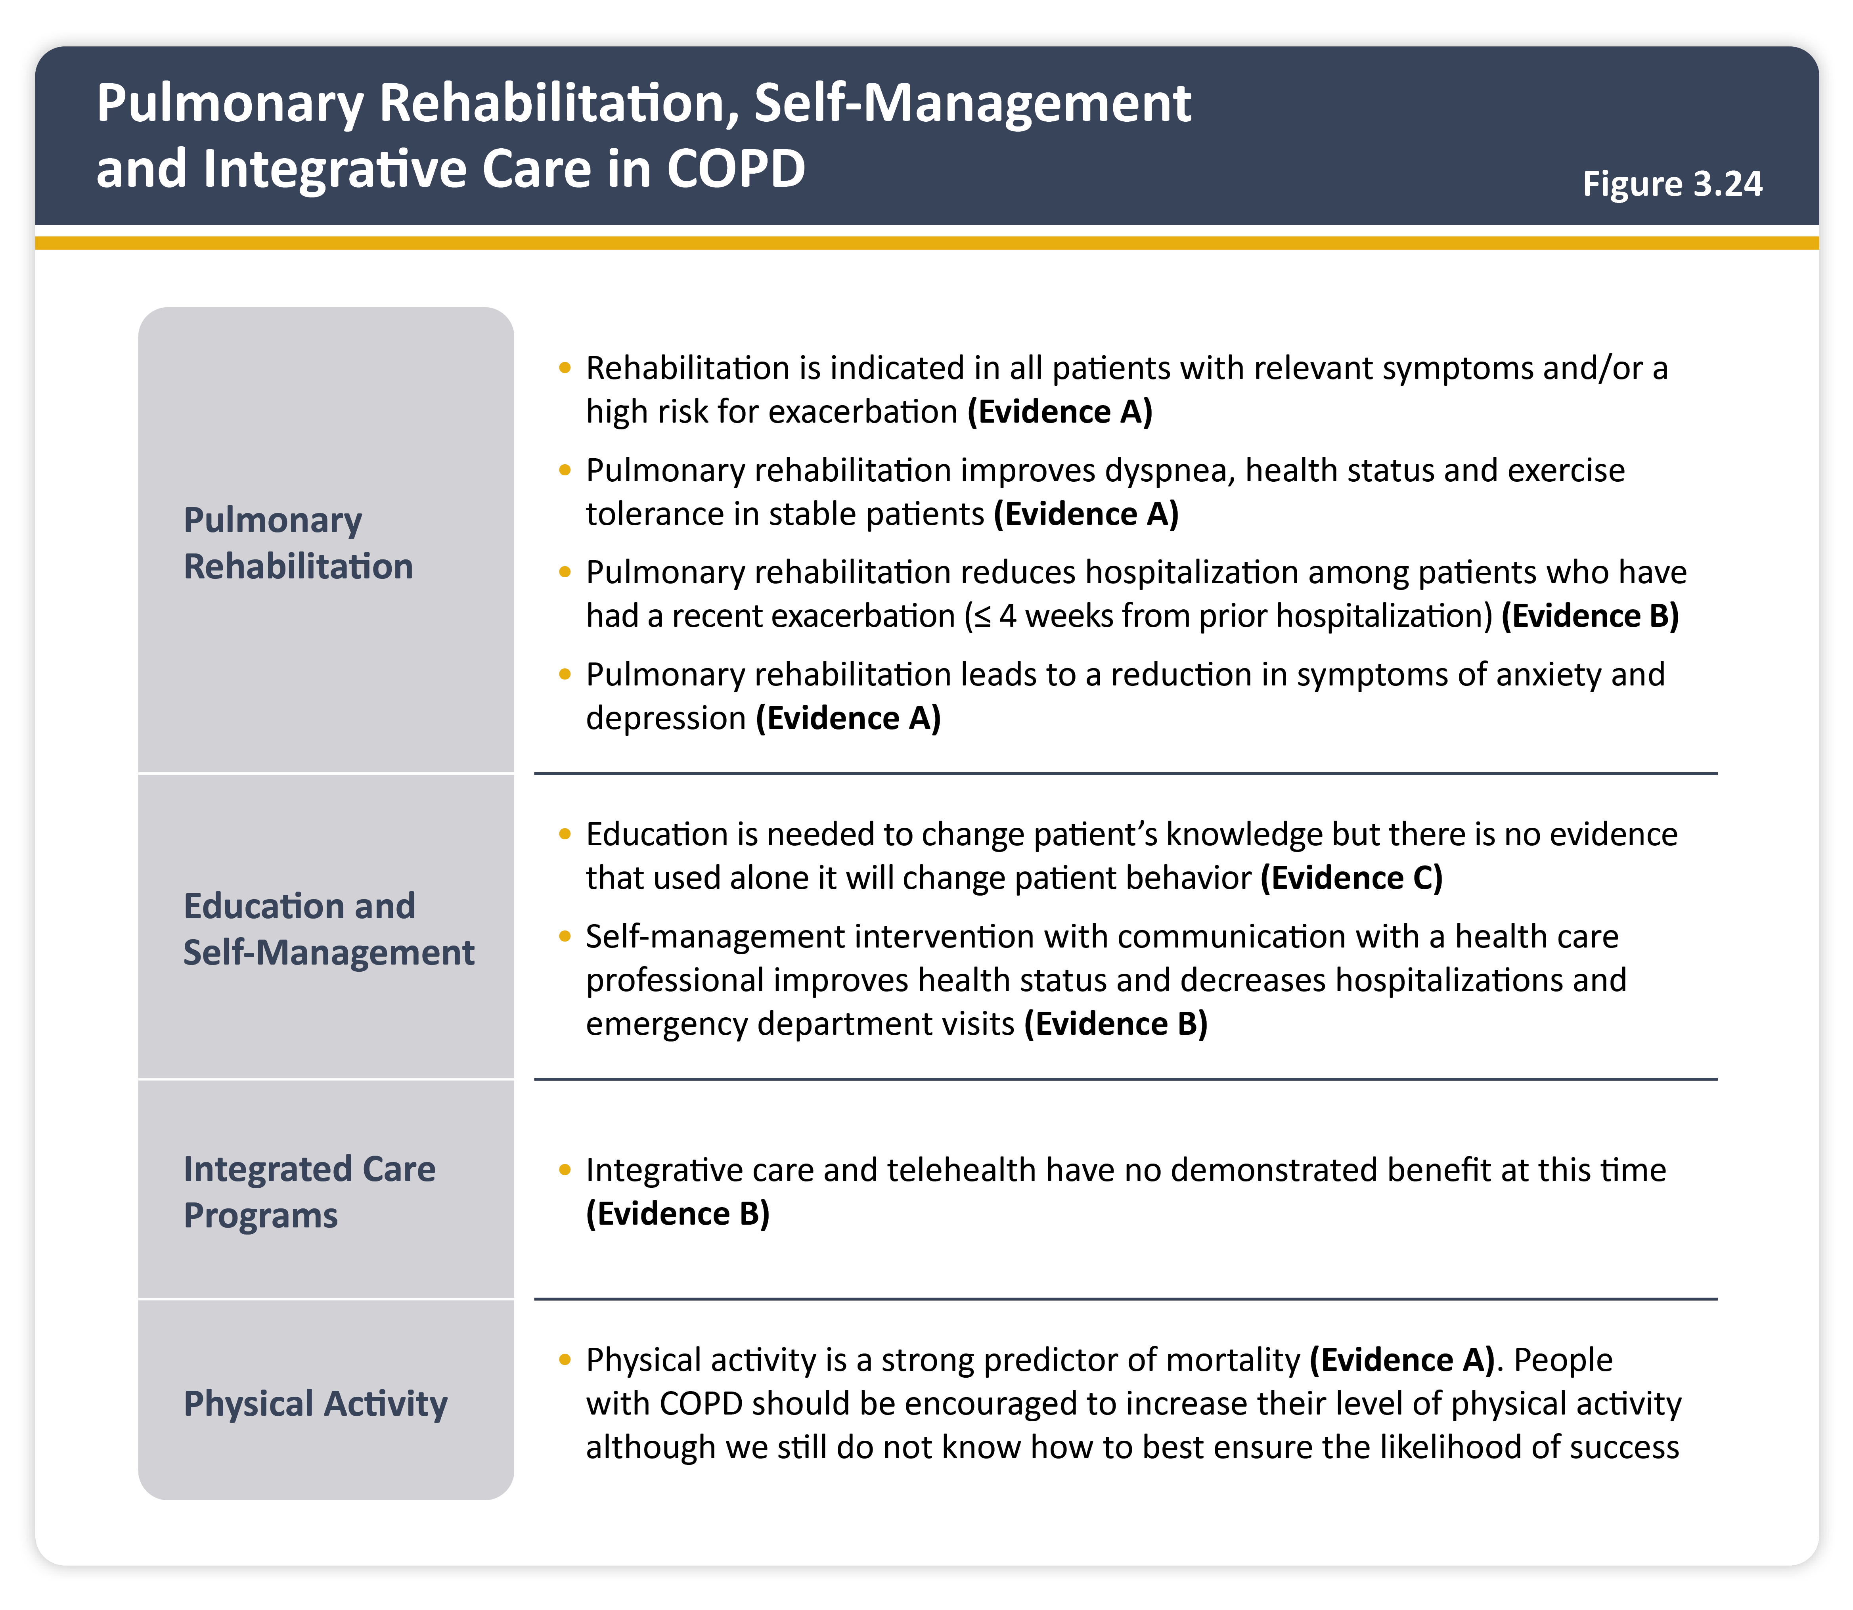
Pulmonary rehabilitation, self-management and integrative care in COPD
Teaching
Slide Set

Slide 41
Overview of current and proposed surgical and bronchoscopic interventions for people with COPD
Teaching
Slide Set

Slide 42
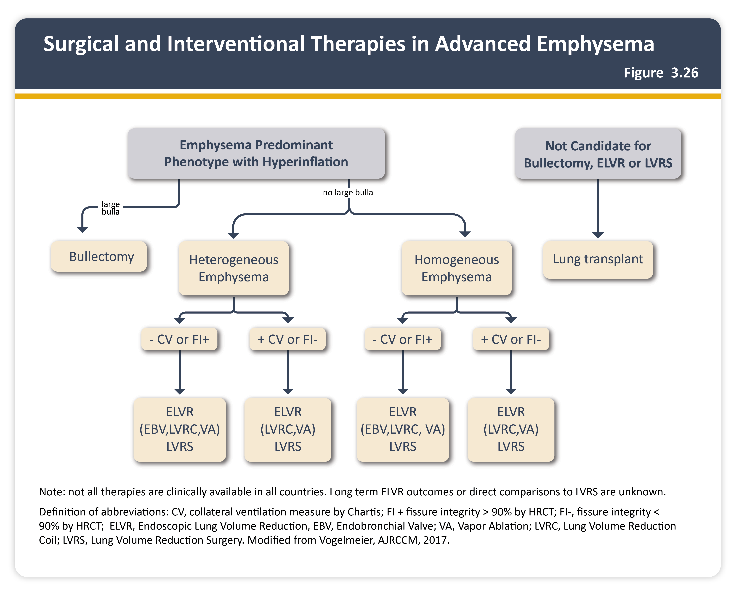
Surgical and interventional therapies in advanced emphysema
Teaching
Slide Set

Slide 43
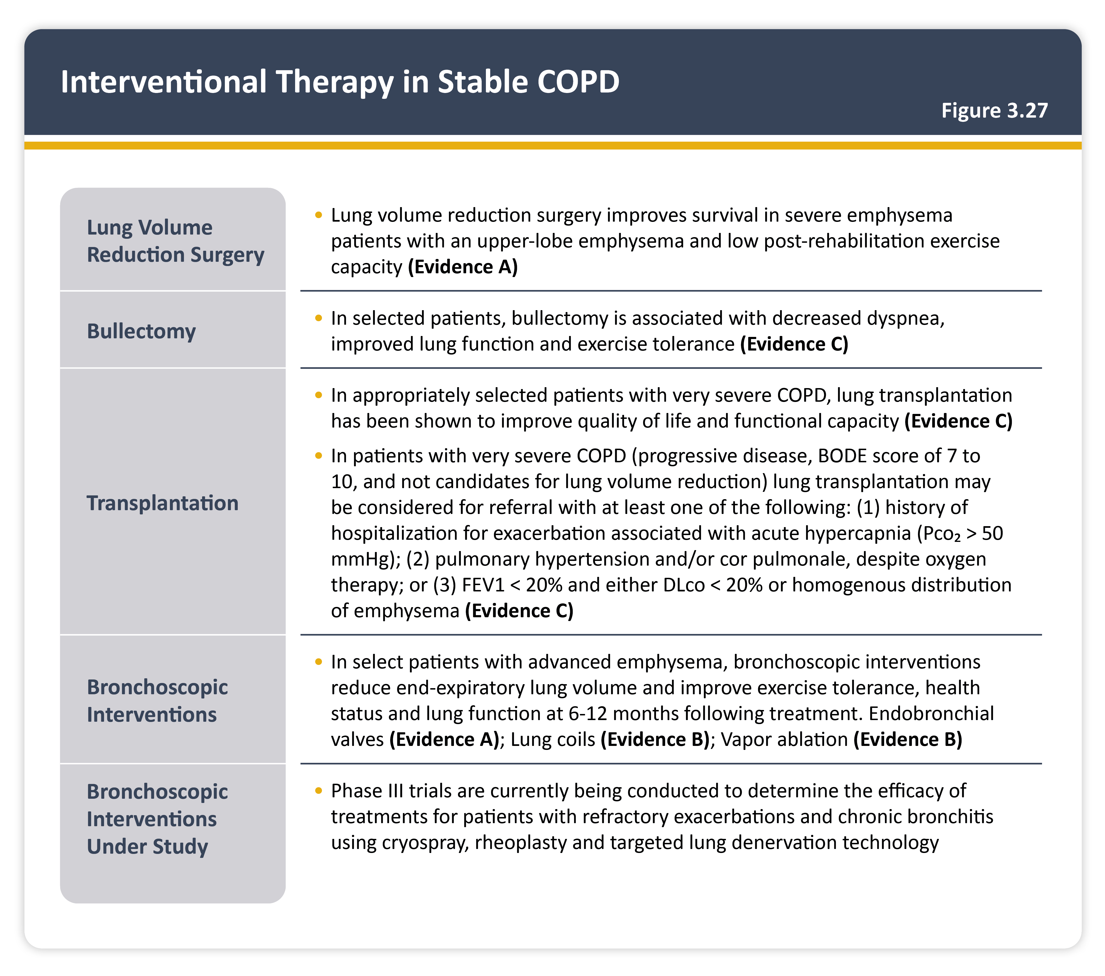
Interventional therapy in stable COPD
Teaching
Slide Set

Slide 44
Confounders or contributors to be considered in patients presenting with suspected COPD exacerbation
Teaching
Slide Set

Slide 45
Diagnosis and assessment
Teaching
Slide Set

Slide 46
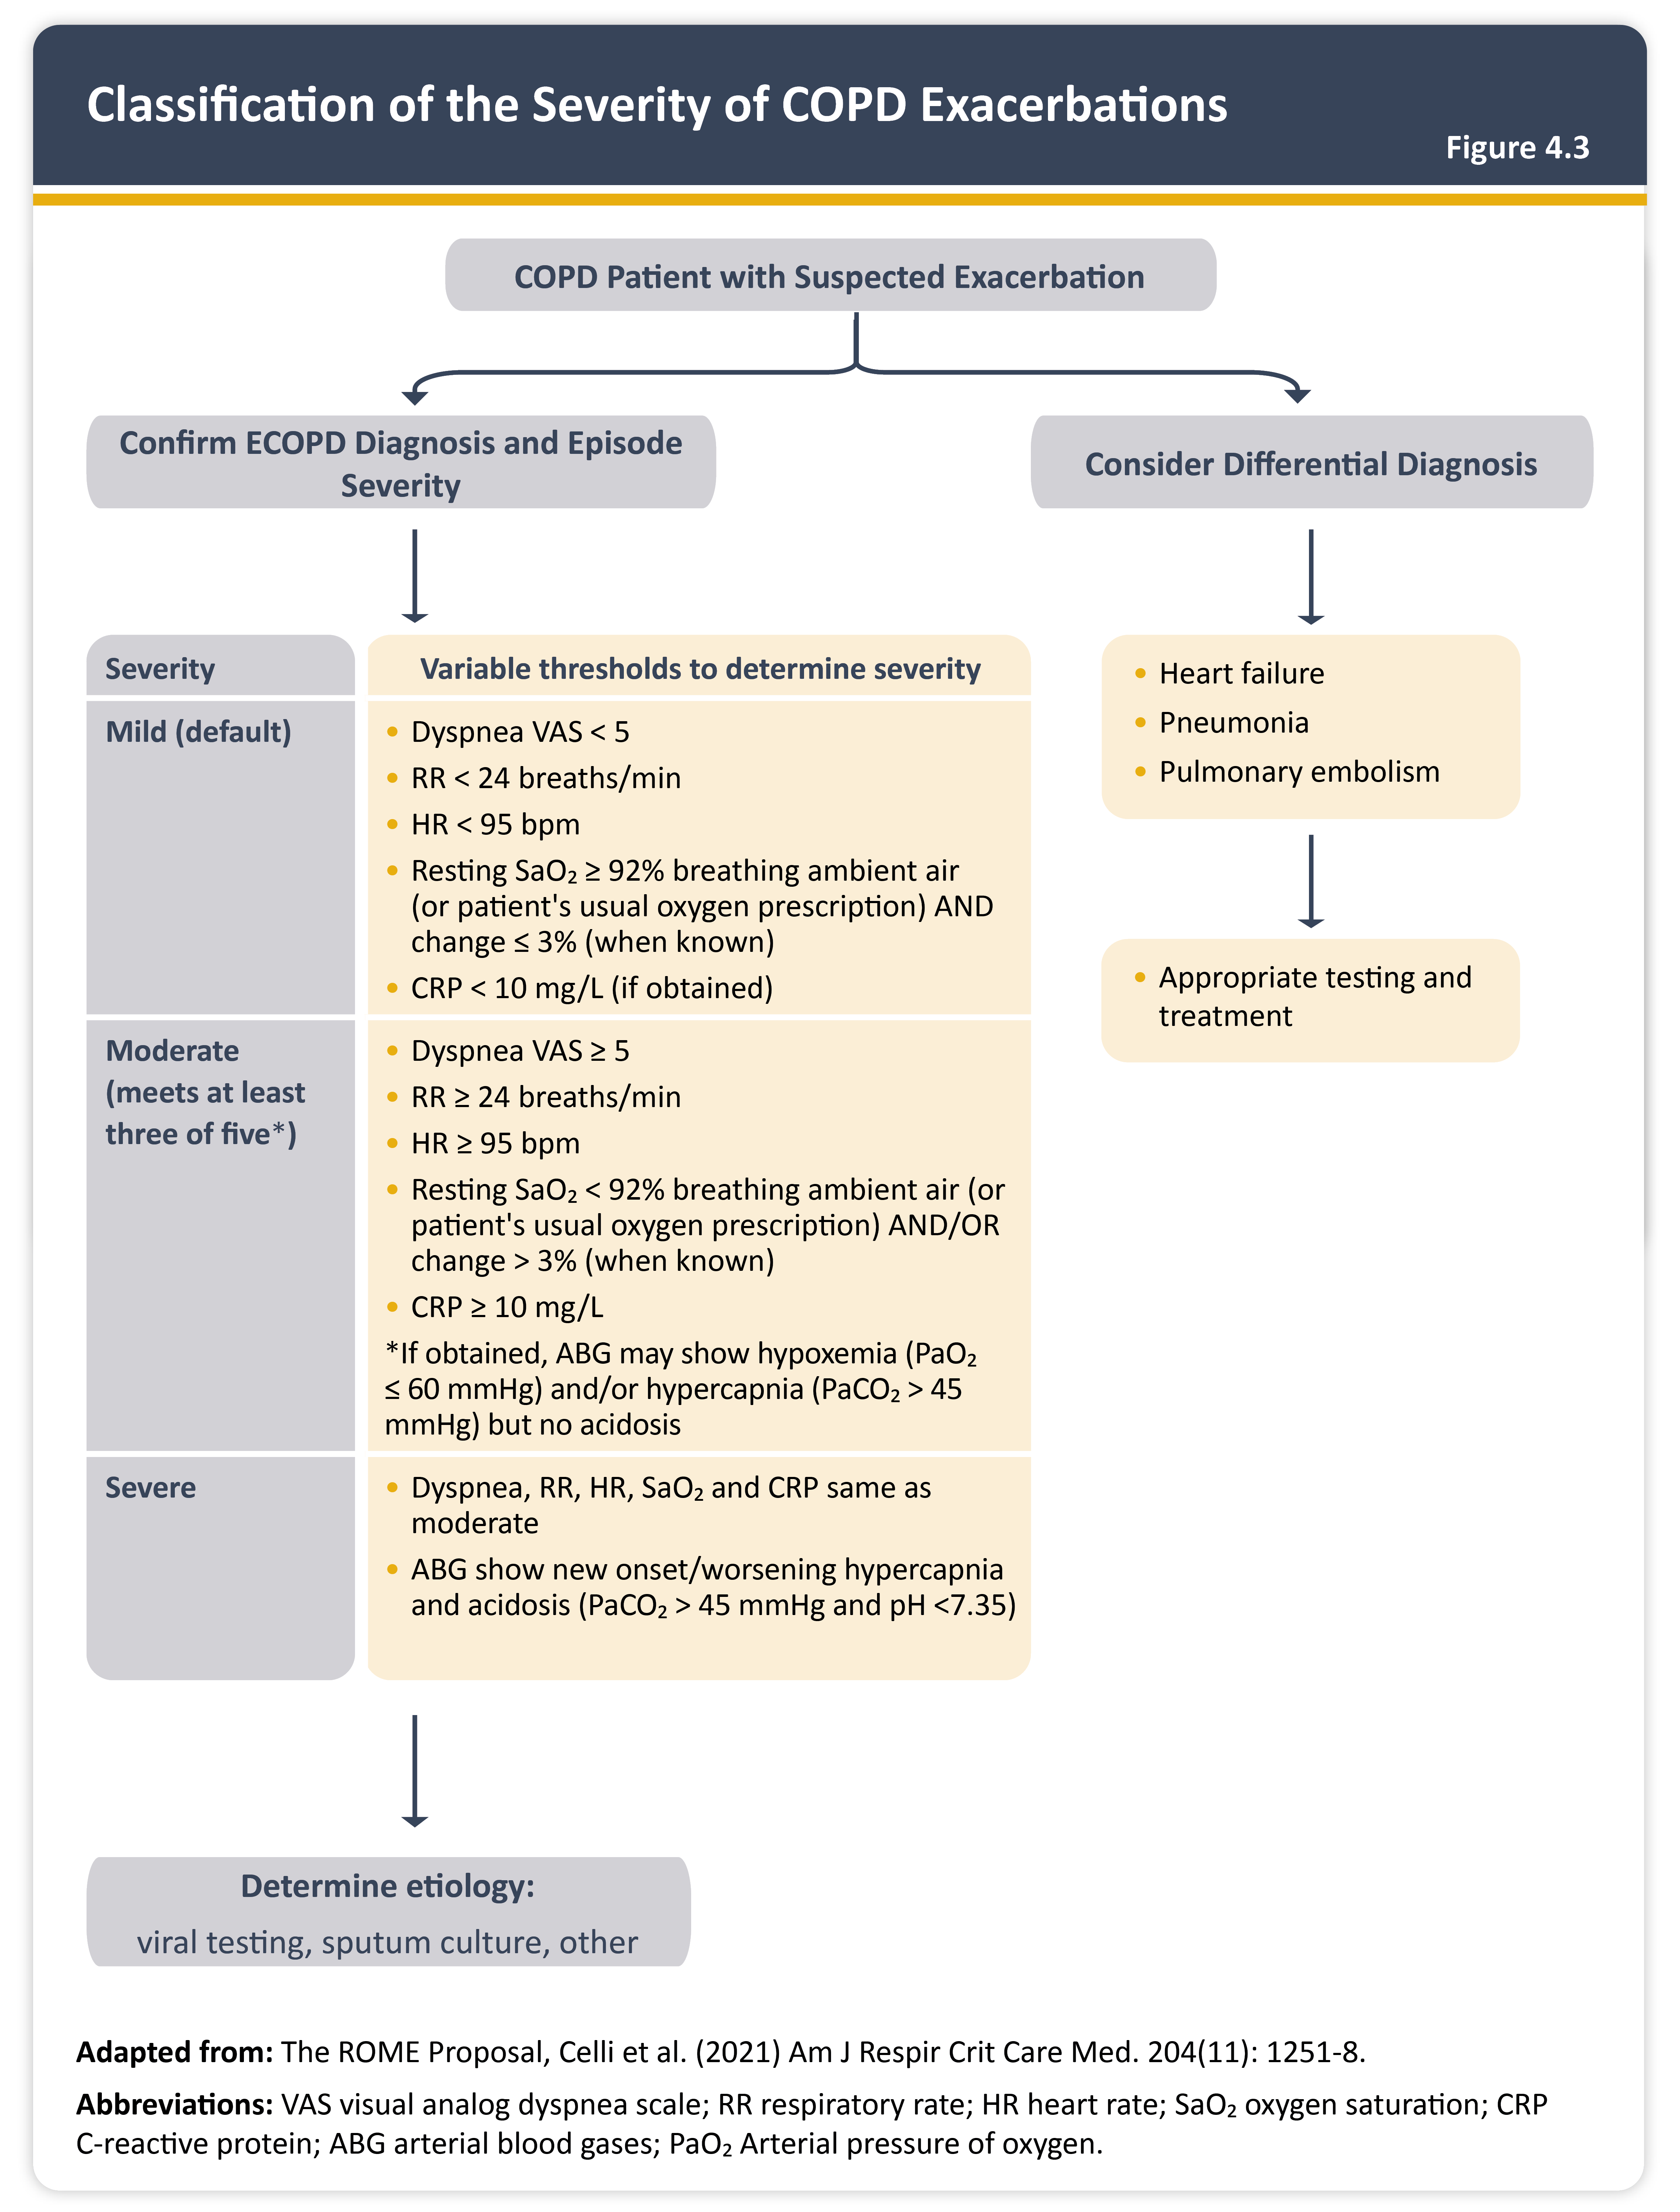
Classification of the severity of COPD exacerbations
Teaching
Slide Set

Slide 47
Potential indications for hospitalization assessment
Teaching
Slide Set

Slide 48
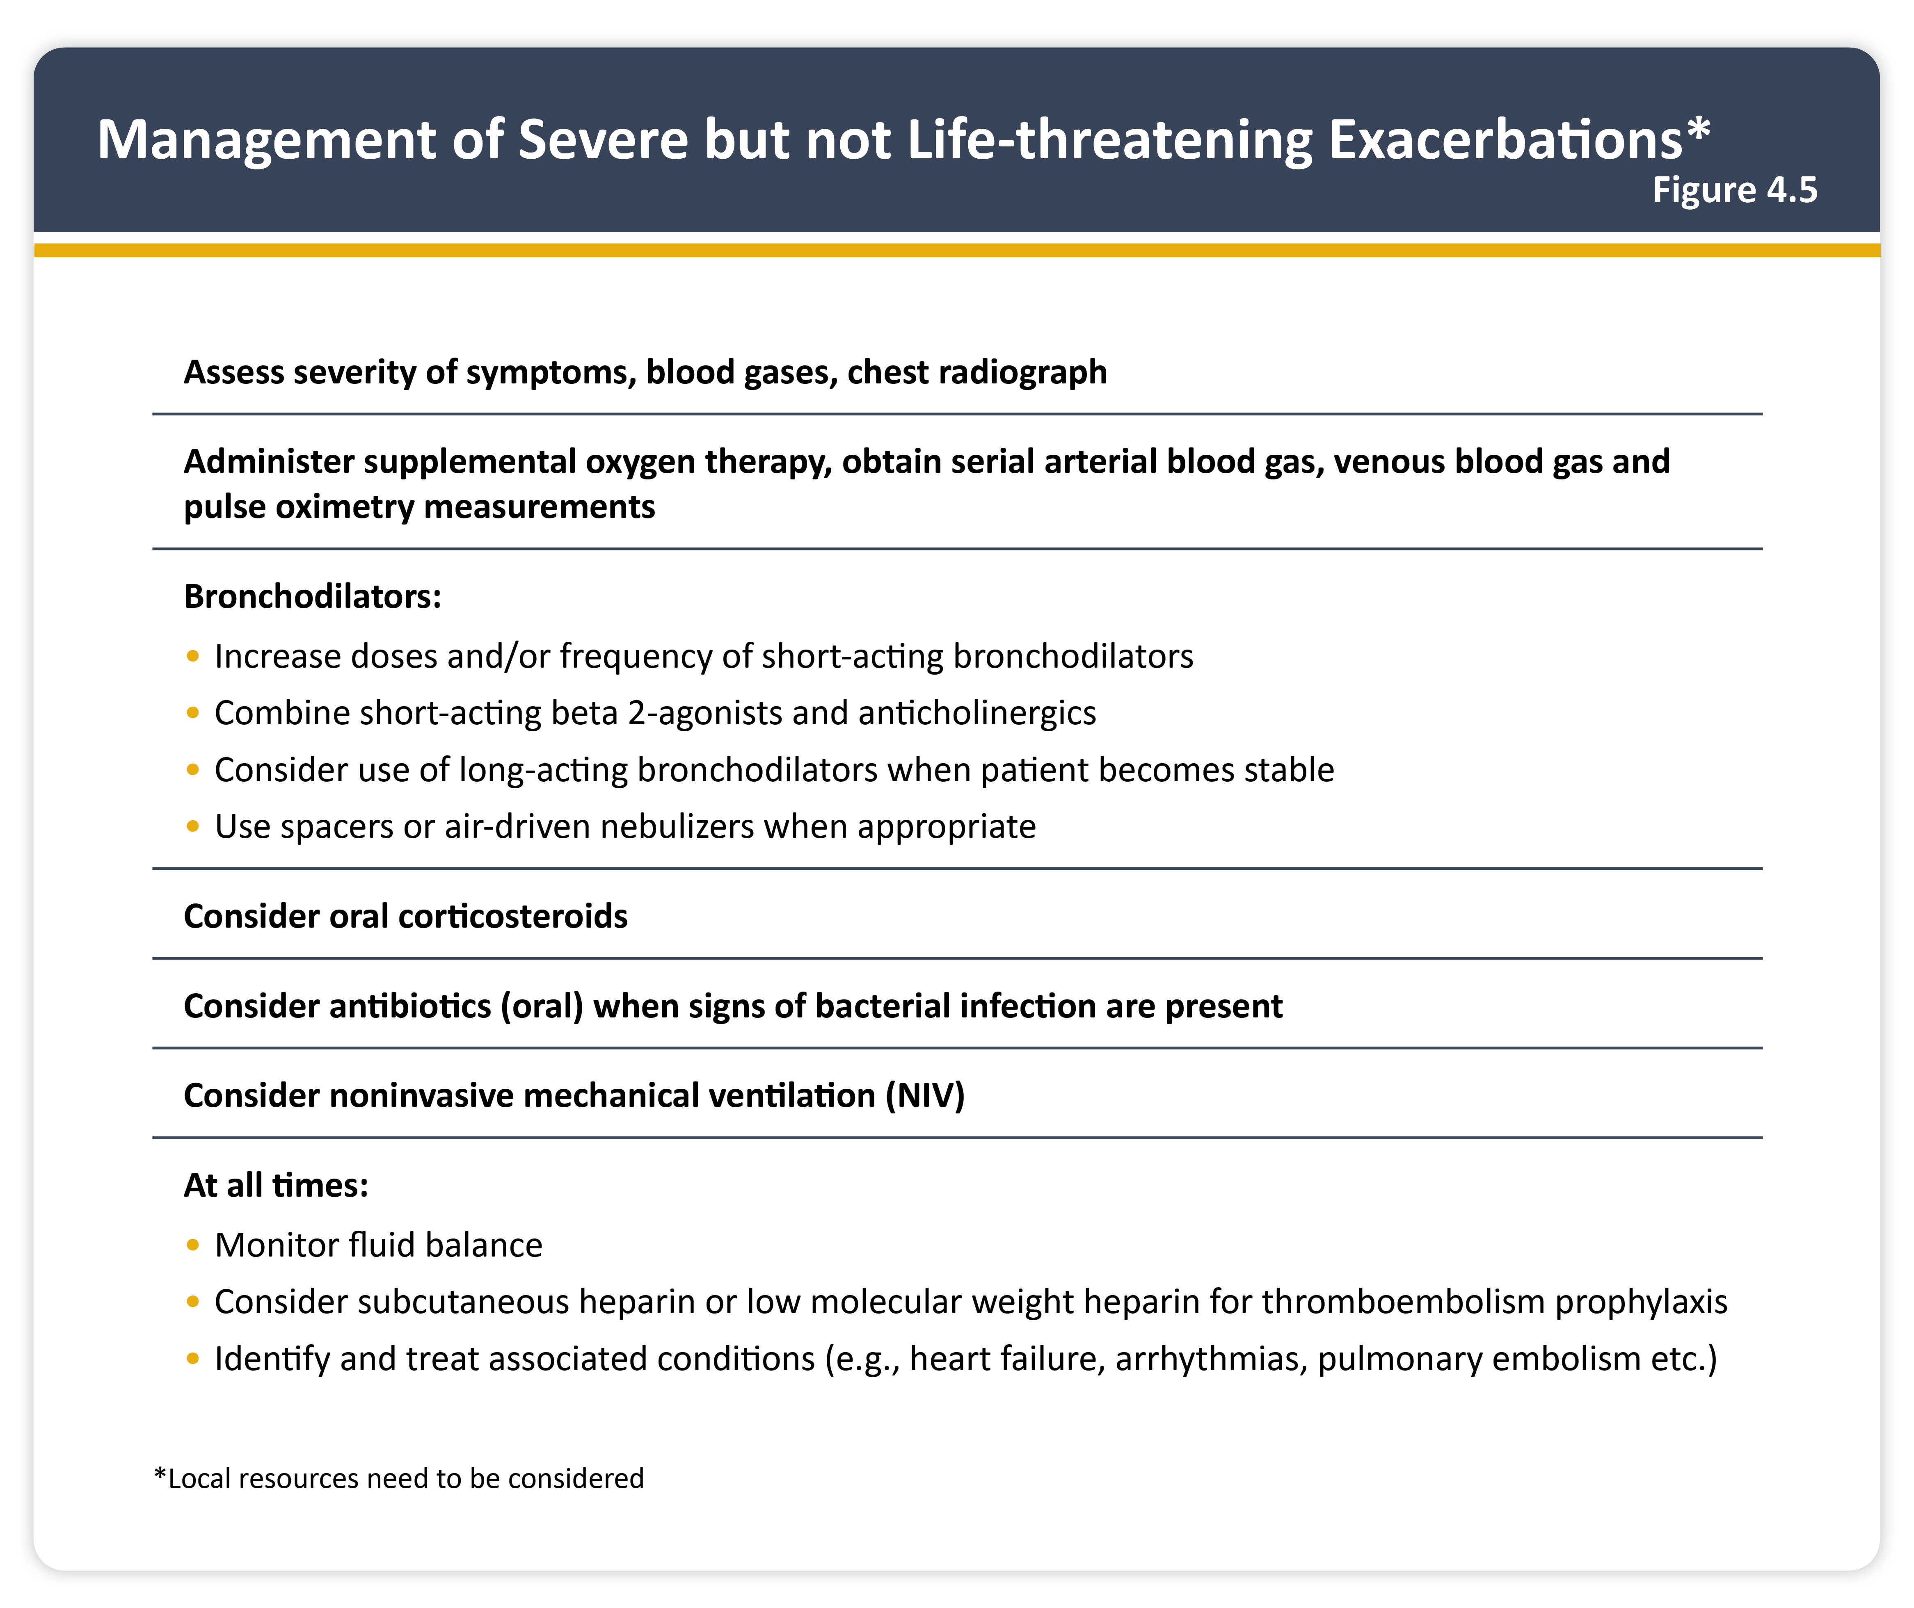
Management of sever but not life-threatening exacerbations
Teaching
Slide Set

Slide 49
Key points for the management of exacerbations
Teaching
Slide Set

Slide 50
Indications for respiratory or medical intensive care unit admission
Teaching
Slide Set

Slide 51
Indications for noninvasive mechanical ventilation (NIV)
Teaching
Slide Set

Slide 52
Indications for invasive mechanical ventilation
Teaching
Slide Set

Slide 53
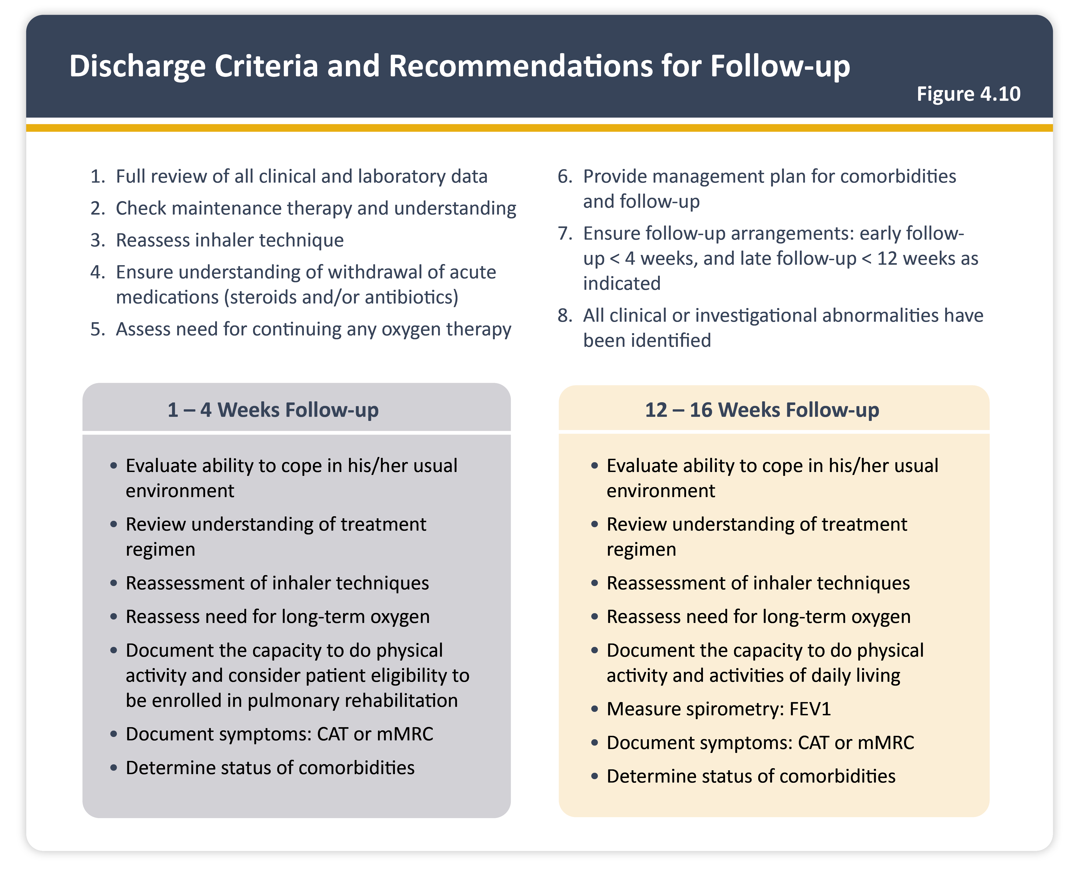
Discharge criteria and recommendations for follow-up
Teaching
Slide Set

Slide 54
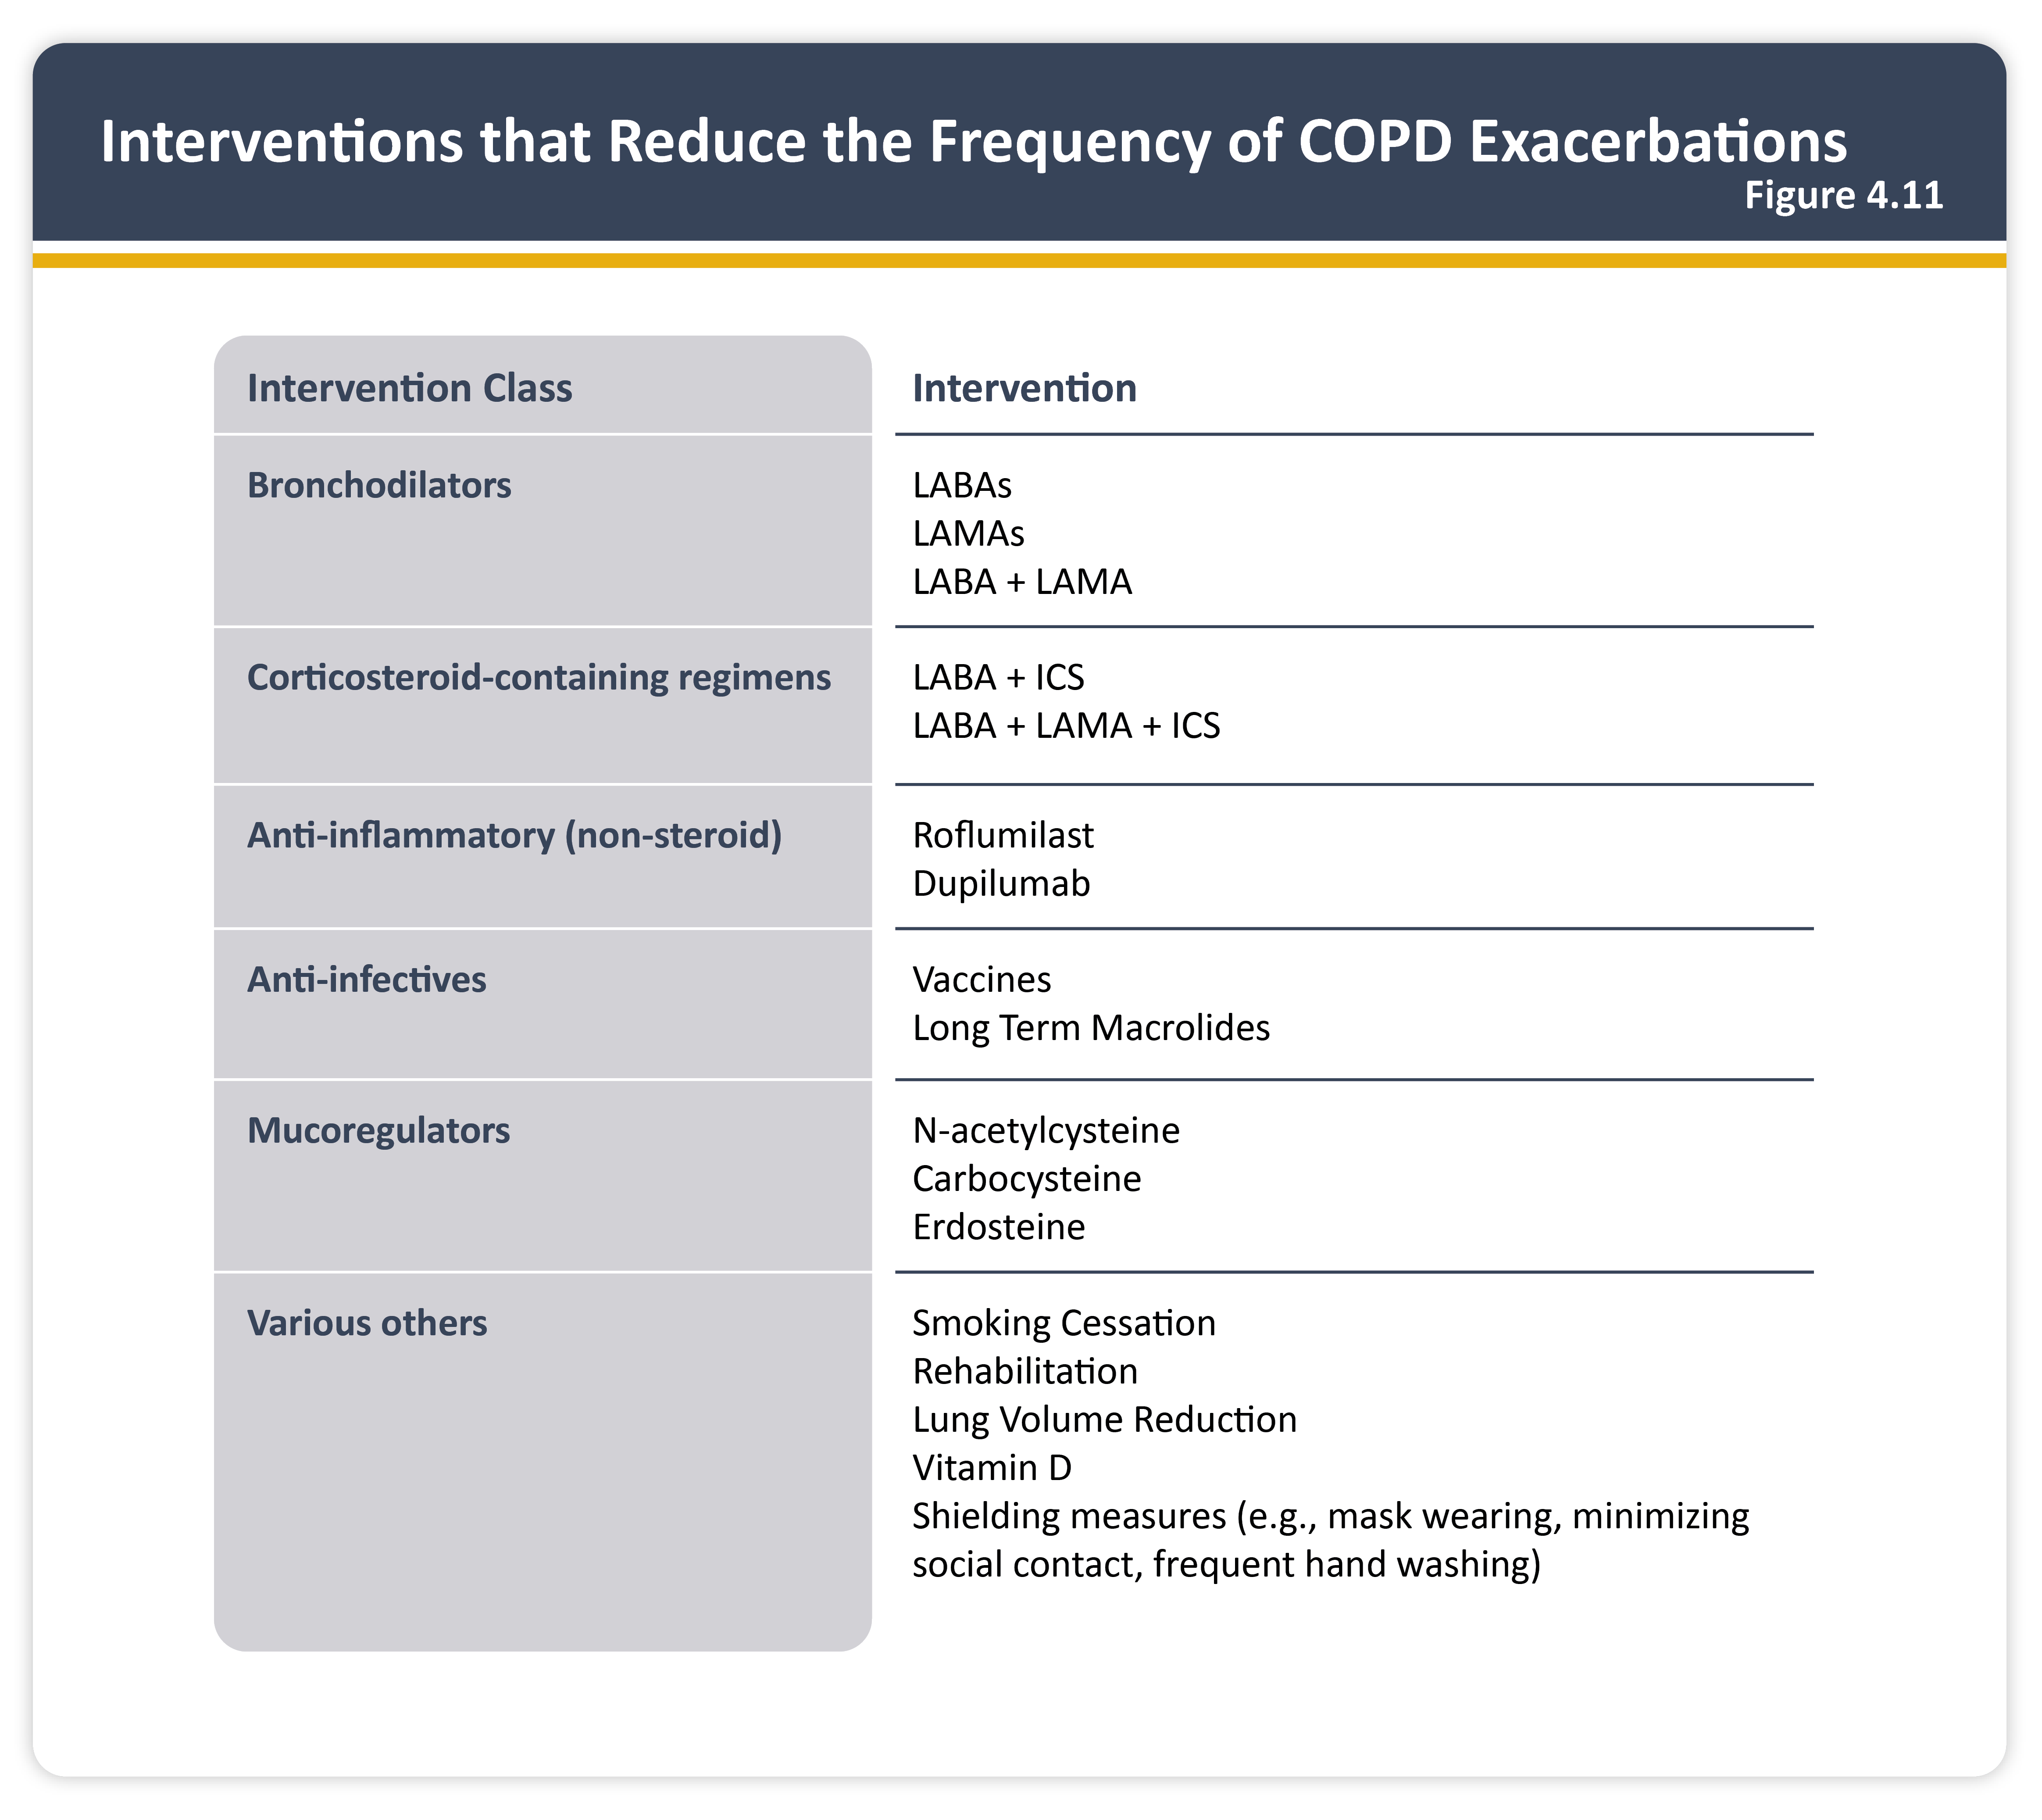
Interventions that reduce the frequency of COPD exacerbations
Teaching
Slide Set

Slide 55
Treatable traits in pulmonary hypertension-COPD (PH-COPD) and suggested management
Teaching
Slide Set

Slide 56
Common risk factors for the development of lung cancer
Teaching
Slide Set

Slide 57
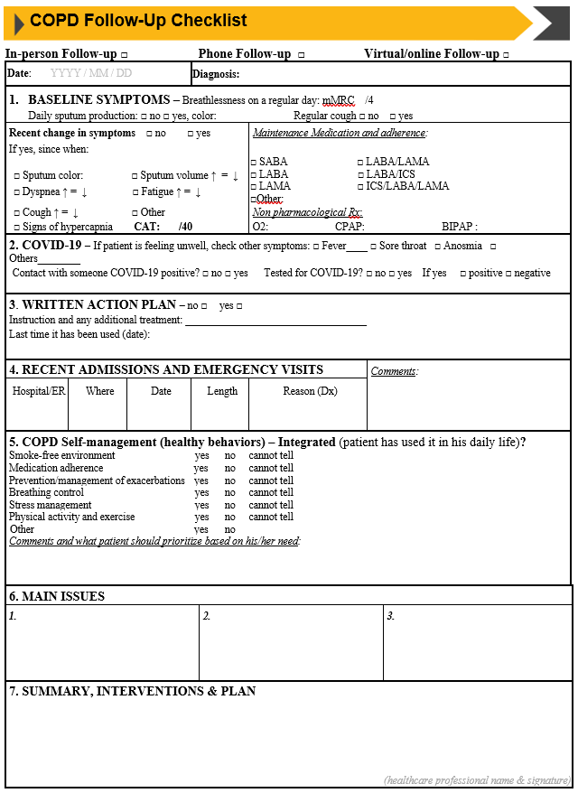
COPD follow-up checklist
Teaching
Slide Set

