Slide 1


INHALE
Monthly PO Update
5/11/26 & 5/13/26

Slide 2
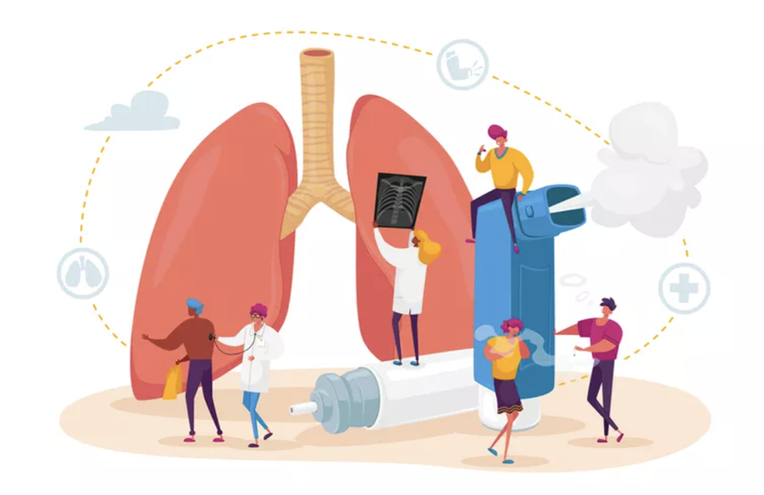
Agenda
Announcements & Reminders
Data Dashboard Release Schedule
2026 Meeting Schedule
Collaborative Wide Meeting
Fall Regional Meetings
Lung Learning Labs
User Feedback Session
ECHO
PCP VBR Attestation
Admin Portal Update – Participating Physicians List
INSPIRING HEALTH ADVANCES IN LUNG CARE

Slide 3
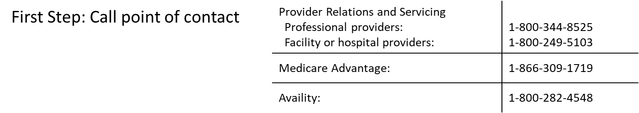
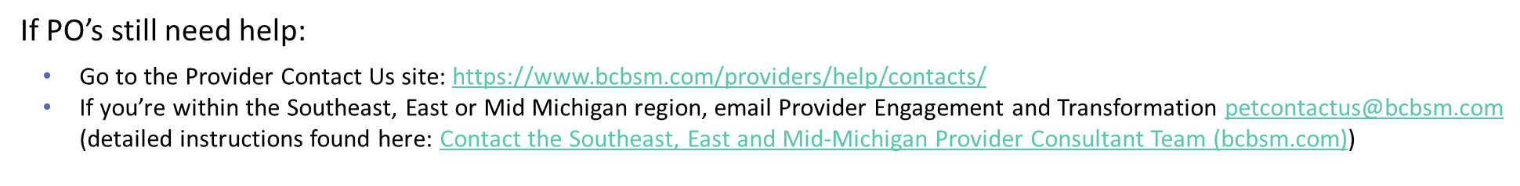
Announcements & Reminders
    Coverage, Billing, Reimbursement, and Prior Authorization:
  BCBSM has established processes in place to manage inquiries related to member specific coverage, billing, and reimbursement issues
INSPIRING HEALTH ADVANCES IN LUNG CARE

Slide 4

Announcements & Reminders
Next PO Monthly Calls
PO 1:1’s
Scheduled as needed with Coordinating Center
Contact @ INHALE-support@med.umich.edu
6/8 at 11a and 6/10 at 2p
INSPIRING HEALTH ADVANCES IN LUNG CARE

Slide 5

Updated Data Release Schedule
Date | Data
May 19th | Data Refresh Data through Mar 2026
Aug 27th | Medicaid Data extract Data through Jun 2026
Oct 29th | Race/ethnicity data Data Aug 2026
Nov 30th | Measurement Year end results Data through Sep 2026
INSPIRING HEALTH ADVANCES IN LUNG CARE

Slide 6
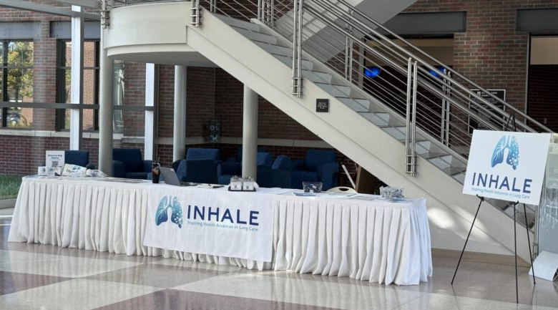
Mark your calendars!
Collaborative Wide Meeting
PO Clinical Champion and PO Admin attendance required for credit.
Meeting will be in-person at Lansing Community College
Thursday, June 4th 8:30a – 3p
Breakfast and lunch are provided
    Registration is open in the Admin Portal
INSPIRING HEALTH ADVANCES IN LUNG CARE

Slide 7

2026 Collaborative Wide Agenda
Time | Topic
8:30-9:00 | Registration/Breakfast
9:10-9:40 | State of INHALE
9:40-10:25 | Keynote Speaker
10:25-10:55 | Partnership
10:55 – 11:10 | Break/Networking
11:10 – 11:55 | Breakout Sessions
11:55-12:55 | Lunch
12:55-1:55 | Data Desegregation
1:55-2:05 | Break
2:05-2:50 | VBR Performance
2:50-3:00 | Closing Remarks
INSPIRING HEALTH ADVANCES IN LUNG CARE

Slide 8

Fall Regional Meetings
Sep 15 – Grand Blanc
Genesys Banquet Conf Center
General Meeting
PO: Genesys, GLPO, McLaren, OPNS,PCP, PMC, UPI
Sep 16 – Ann Arbor
The Kensington
General Meeting
PO: GMP, HVPA, Mosaic, OPNS, UMMG
Sep 22 – Lansing
Lansing Community College
Pediatric and Specialist Focused Meetings
2 simultaneous meetings, same location
Sep 30 – Traverse City
Haggerty Center
General Meeting
PO: NMCP
Oct 1 – Grand Rapids
Calvin University
General Meeting
PO: Answer, CIPA, Holland, IHP, Lakeland, Spectrum
INSPIRING HEALTH ADVANCES IN LUNG CARE
Notes:
If you have any patients or caregivers who are interested please send them our way!

Slide 9
Fall Regional Meetings cont'd
All meetings are from 6p to 8p
Practice Clinical Champions are required
May register for preferred location
If planning to attend the Pediatric or SCP meeting, not required to attend another meeting
Reminder: if a proxy was sent within the last year, no proxy will be granted this time
Registration opens Monday, June 1st in the Admin Portal
INSPIRING HEALTH ADVANCES IN LUNG CARE

Slide 10
Lung Learning Labs
5/19/2026 12:00pm – 1:00pm
  Speaker: Dr. Sara Ellingwood
  The role of allergic sensitization, mitigation strategies, and immunotherapy in Asthma
6/16/2026 12:00pm-1:00pm
  Speaker: Dr. William Anderson
  The management of Asthma in school age children
7/9/2026 12:00p-1:00pm
  Speaker: Dr. Stephanie Christenson
  Type 2 inflammation in COPD
Registration open in the Admin Portal
INSPIRING HEALTH ADVANCES IN LUNG CARE

Slide 11

INHALE User Feedback Session for PCP/SCP
Continuing PCP/SCP Scorecard Bonus Activity:
Participate in a user experience feedback session on the potential redesign of the INHALE Data Dashboard
Date and Time:
May 13, 2026 12:00pm - 1:00pm via Zoom
During this session:
Feedback from PCP/SCP end users on the Data Dashboard and other INHALE tools
Bonus points will be awarded to those who register in advance and take part in the virtual session
May 13
12:00-1:00pm
REGISTER TODAY!
INSPIRING HEALTH ADVANCES IN LUNG CARE
Notes:
1. Modern, more organized homepage layout
The new site features a clean, updated homepage with clear sections for different audiences — Patients, Providers, and INHALE Members — making it easier for visitors to find relevant information right away. It also highlights key initiative areas and program statistics (e.g., number of participating providers and resources available) on the homepage itself, giving a quick snapshot of the CQI’s reach and impact.
2. Improved navigation with streamlined menus
The new site has restructured navigation with intuitive top-level menus including About Us, Initiatives, Measures, Resources, and Members — helping users jump directly to program content, dashboards, toolkits, and portals without clicking through multiple pages.
3. Dedicated resource organization
While the old site lists toolkits and resources under broader menus, the new site centralizes the Resource Library and Toolkits, and integrates them into primary navigation — making educational materials, toolkits, and support resources easier to access.
4. Clear pathways to key external tools
The new website explicitly links to essential portals like the Data Dashboard and Admin Portal, and lays them out as separate navigation items rather than buried links. This helps physician organizations and members more quickly access the systems they use for CQI participation and reporting.
5. “Help” and direct support features
The updated site includes a dedicated Help section (e.g., Ask the Pharmacist and Contact Us) visible in the main menu — providing easier access to support compared with the older structure.
6. Enhanced visuals and storytelling elements
The new layout features imagery or visual statistics (e.g., counts of provider organizations, resources, and courses) and sections like Lung Health News and Insights that showcase updates and learning opportunities in a more engaging way than the largely text-heavy old site.
7. Audience-specific content blocks
Instead of a general homepage, the new design splits content by audience type — patients vs. providers vs. members — helping each group more quickly find relevant resources and information tailored to their needs.
In contrast, the old site offered robust informational content (e.g., QI initiatives, committee information, toolkits, and Dashboard access) but with broader menus and less visual prioritization of key content areas, making it harder to navigate at a glance. The new site focuses on improved user experience through clearer navigation, more engaging presentation, and better organization of key tools and resources.

Slide 12


INHALE Site Visits
A collaborative meeting at a practice where an exchange of information occurs.
Agenda is collaborative and includes items the practice would like to review.
Preference is that practice has some understanding of INHALE tools, platforms, and performance measures prior to visit.
Not an Audit
Use the Admin Portal to schedule a Site Visit
Counts as an engagement activity on the scorecard.
Scan the QR code to request a Site Visit
INSPIRING HEALTH ADVANCES IN LUNG CARE
Notes:
1. Modern, more organized homepage layout
The new site features a clean, updated homepage with clear sections for different audiences — Patients, Providers, and INHALE Members — making it easier for visitors to find relevant information right away. It also highlights key initiative areas and program statistics (e.g., number of participating providers and resources available) on the homepage itself, giving a quick snapshot of the CQI’s reach and impact.
2. Improved navigation with streamlined menus
The new site has restructured navigation with intuitive top-level menus including About Us, Initiatives, Measures, Resources, and Members — helping users jump directly to program content, dashboards, toolkits, and portals without clicking through multiple pages.
3. Dedicated resource organization
While the old site lists toolkits and resources under broader menus, the new site centralizes the Resource Library and Toolkits, and integrates them into primary navigation — making educational materials, toolkits, and support resources easier to access.
4. Clear pathways to key external tools
The new website explicitly links to essential portals like the Data Dashboard and Admin Portal, and lays them out as separate navigation items rather than buried links. This helps physician organizations and members more quickly access the systems they use for CQI participation and reporting.
5. “Help” and direct support features
The updated site includes a dedicated Help section (e.g., Ask the Pharmacist and Contact Us) visible in the main menu — providing easier access to support compared with the older structure.
6. Enhanced visuals and storytelling elements
The new layout features imagery or visual statistics (e.g., counts of provider organizations, resources, and courses) and sections like Lung Health News and Insights that showcase updates and learning opportunities in a more engaging way than the largely text-heavy old site.
7. Audience-specific content blocks
Instead of a general homepage, the new design splits content by audience type — patients vs. providers vs. members — helping each group more quickly find relevant resources and information tailored to their needs.
In contrast, the old site offered robust informational content (e.g., QI initiatives, committee information, toolkits, and Dashboard access) but with broader menus and less visual prioritization of key content areas, making it harder to navigate at a glance. The new site focuses on improved user experience through clearer navigation, more engaging presentation, and better organization of key tools and resources.

Slide 13


ECHO: Call for Cases
Call for INHALE ECHO Case Submissions: We are seeking cases for the INHALE ECHOs!
Submit cases through a secure form that are:
Difficult to treat
Medication change questions
Need access to specialist care quickly
Need access to a community of learning and support
  Please remember to deidentify all information submitted
During the session:
Receive support from specialists and/or peers
After the session:
Receive summary of discussion and next steps
Will we offer VBR? Yes – if the case is selected, the provider will receive 5 bonus points on the scorecard
The next INHALE ECHO
is scheduled for
May 28th, 2026
12:00-1:00pm
Submit a case here:
INSPIRING HEALTH ADVANCES IN LUNG CARE

Slide 14

Patient Advisory Board (PAB)
What is the INHALE Patient Advisory Board?
The INHALE PAB is a group of 8 advisors who:
Bring the patient voice to INHALE's work
Give input and create educational resources and tools for patients
Work with the community to help people understand how to best take care of their lungs
Brainstorm ideas for improvement to care
The PAB meets on Zoom (virtually) every other month
Members are paid for their time
Please have interested patients contact us at the form on our website or email us:
inhale-support@med.umich.edu
We are looking for new members!​
Scan below for more information
Remember a nomination is a 5-point bonus activity for VBR!
INSPIRING HEALTH ADVANCES IN LUNG CARE
Notes:
If you have any patients or caregivers who are interested please send them our way!

Slide 15

PCP VBR Attestion
Attestations open May 15th in Admin Portal
Close on May 29th – no exceptions
This list includes all PCPs receiving VBR as of 9/1/26
Includes any PCPs nominated in March 2026 for existing practices
Verify names and total number of expected PCPs
Will have projected VBR award based on INHALE Scorecard
  Not final until reviewed by BCBSM
Navigate to the INHALE Admin Portal
Click on the Provider Attestation list in the black menu on the left
Ensure you read the entire attestation prior to signing
Enter full name in the Signature box
  Date should autopopulate once you enter your signature
  Click, Submit
DO NOT submit form if your list is incorrect – contact the Coordinating Center ASAP!
INSPIRING HEALTH ADVANCES IN LUNG CARE
Notes:
If you have any patients or caregivers who are interested please send them our way!

Slide 16
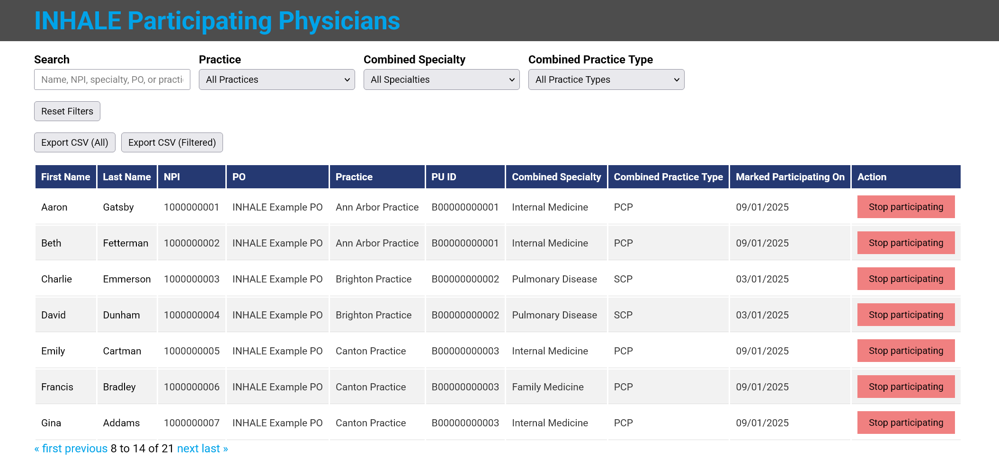
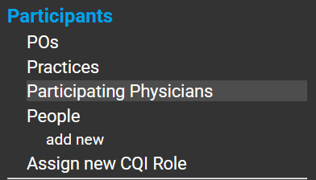
Admin Portal Update
Participating Physicians List
A new page has been added to the Admin Portal to aid POs in managing their Physicians who participate in INHALE.
INSPIRING HEALTH ADVANCES IN LUNG CARE
Notes:
If you have any patients or caregivers who are interested please send them our way!

Slide 17
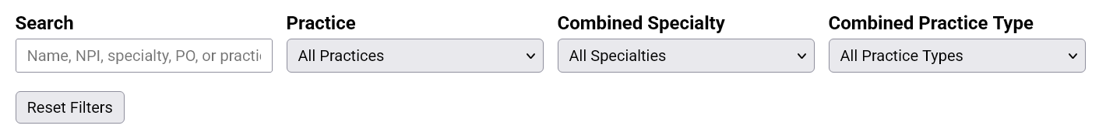

Admin Portal Update – How To Use
Searching
Utilize the search bar or drop-down menus to quickly find a Physician. Reset the filters with the Rest Filters button.
Exporting list
Export the full list or just the select few you have filtered.
INSPIRING HEALTH ADVANCES IN LUNG CARE
Notes:
If you have any patients or caregivers who are interested please send them our way!

Slide 18

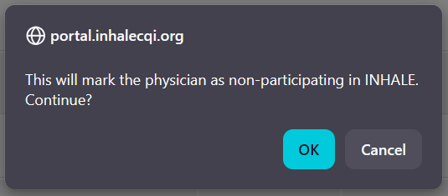
Admin Portal Update – How To Use
Participating
Click the red 'Stop participating' button to update a physician's status in INHALE. An alert box will appear for you to confirm your choice before it is official.
INSPIRING HEALTH ADVANCES IN LUNG CARE
Notes:
If you have any patients or caregivers who are interested please send them our way!

Slide 19

Questions
INSPIRING HEALTH ADVANCES IN LUNG CARE

Slide 20





Contact
INHALE-support@med.umich.edu
www.inhalecqi.org
@INHALE_cqi
@inhale-cqi.bsky.social
MichiganDataCollaborative@med.umich.edu
Technical support with data hub or access concerns
INSPIRING HEALTH ADVANCES IN LUNG CARE

